Slide 1
MSDM5003 Fall 21/22 Final Project Adaptive Minority Game
Group 28
Chan Shiu Kai
Cheng Wing Kit

Slide 2
Agenda
Minority Game
Adaptive Minority Game
Adaptive Schemes
Collective Behavior
Revenging Ability
Relative Performance
Conclusion

Slide 3
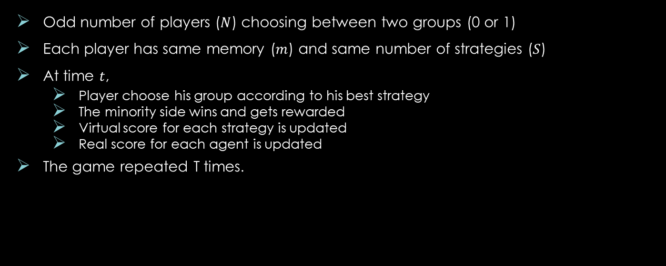
1. Minority Game
Odd number of players ($N$) choosing between two groups (0 or 1)
Each player has same memory ($m$) and same number of strategies ($S$)
At time $t$,
Player choose his group according to his best strategy
The minority side wins and gets rewarded
Virtual score for each strategy is updated
Real score for each agent is updated
The game repeated T times.
Minority: score +1
Majority

Slide 4
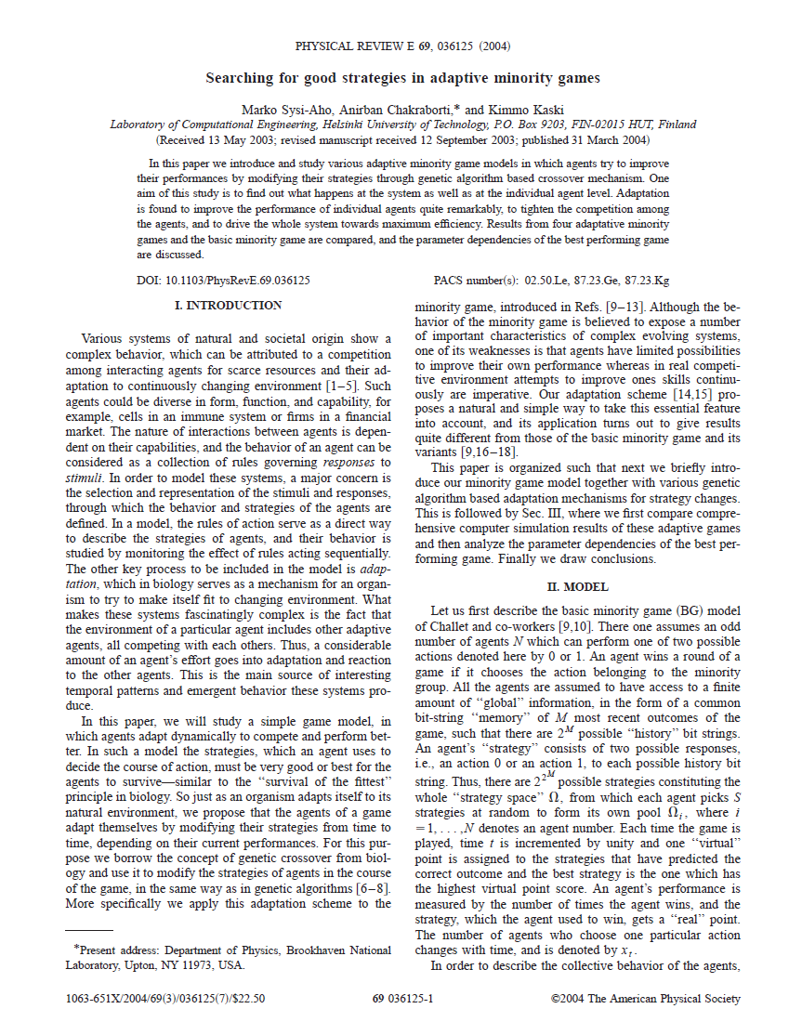
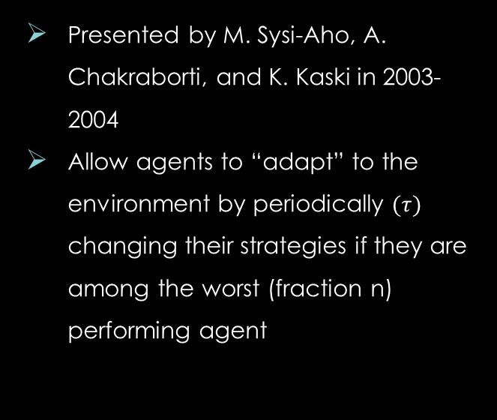
Adaptive Minority Game
Presented by M. Sysi-Aho, A. Chakraborti, and K. Kaski in 2003-2004
Allow agents to “adapt” to the environment by periodically $(τ)$ changing their strategies if they are among the worst (fraction n) performing agent

Slide 5
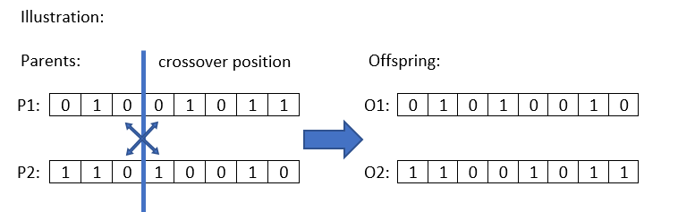
Adaptive Schemes
One-point genetic crossover scheme:
Two strategies is selected as parents
One random position is generated
Two offspring strategies are generated after crossover
Two strategies are selected to be replaced.
Different versions of crossover scheme depending on the choice of parent strategies and strategies to be replaced.

Slide 6
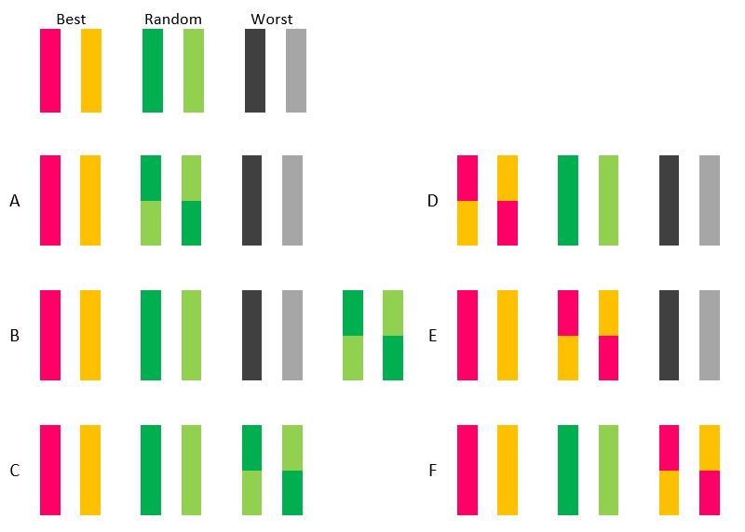
Adaptive Schemes
6 crossover schemes are studied
Scheme | Parents | Offspring replacing
A | Random 2 | Same
B | Random 2 | Random 2
C | Random 2 | Worst 2
D | Best 2 | Same
E | Best 2 | Random 2
F | Best 2 | Worst 2

Slide 7
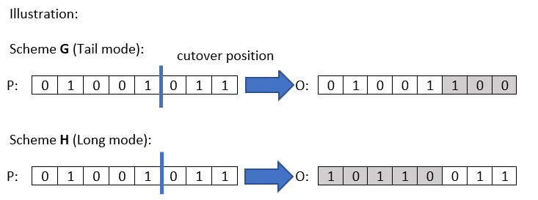
Adaptive Schemes
One-point genetic mutation scheme:
Two worst strategies are selected
One random position is generated
Two offspring strategies are generated after mutation
2 versions of mutation scheme are studied
Tail of the strategy string flipped
Longer part of the strategy string flipped

Slide 8
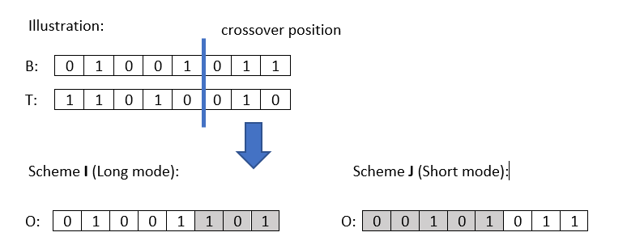
Adaptive Schemes
One-point genetic crossover-mutation scheme:
The best strategy is selected as parent
Two random position generated
Two worst strategies are selected for mutation
Two offspring strategies generated by crossover of best strategy with the mutated strategy
2 versions of crossover-mutation scheme are studied
Longer part of the best strategy used
Shorter part of the best strategy used

Slide 9
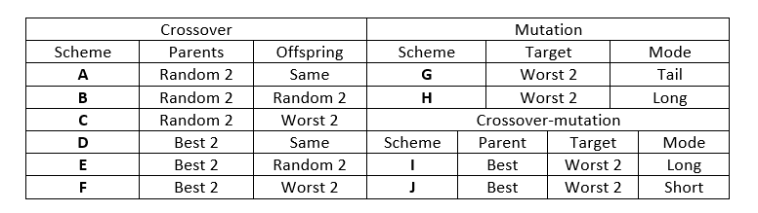
Adaptive Schemes
10 adaptive schemes are studied including:
6 crossover schemes (Scheme A – F)
2 mutation schemes (Scheme G and H)
2 crossover-mutation schemes (Scheme I and J)

Slide 10
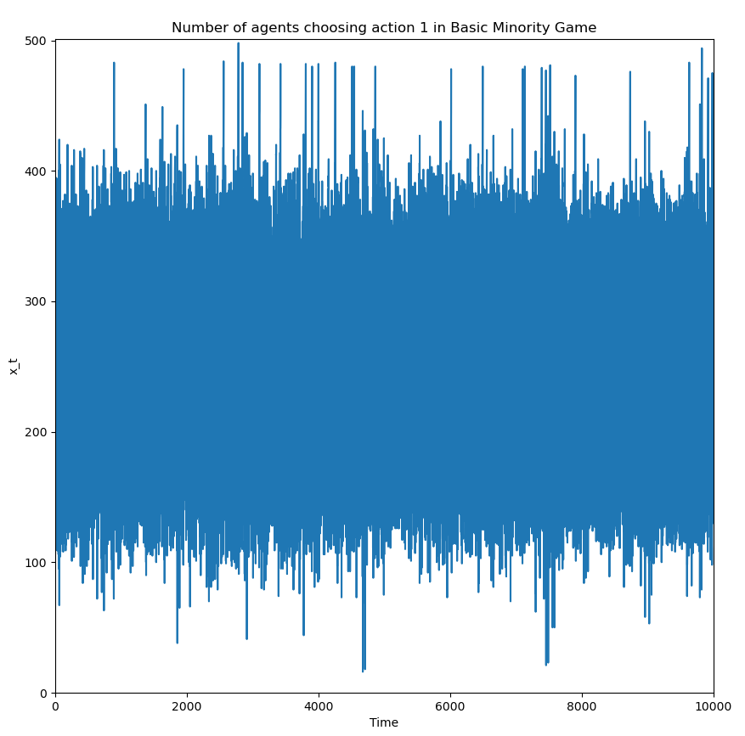
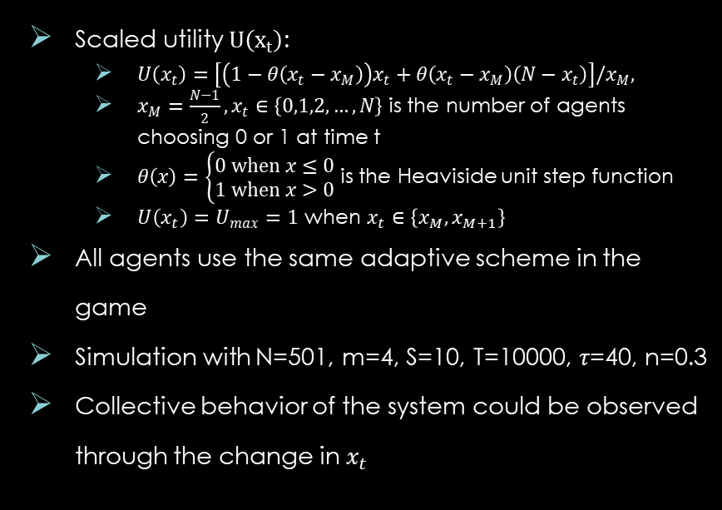
Collective Behaviors
Scaled utility $U\left(x_{t}\right)$:
$U\left(x_{t}\right)=\left[\left(1−θ\left(x_{t}−x_{M}\right)\right)x_{t}+θ\left(x_{t}−x_{M}\right)\left(N−x_{t}\right)\right]/x_{M},$
$x_{M}=\frac{N−1}{2}, x_{t}∈\left\{0,1,2,…,N\right\}$ is the number of agents choosing 0 or 1 at time t
$θ\left(x\right)=\left\{\begin{aligned}0 when x≤0 \\ 1 when x>0\end{aligned}\right.$ is the Heaviside unit step function
$U\left(x_{t}\right)=U_{max}=1$ when $x_{t}∈\left\{x_{M},x_{M+1}\right\}$
All agents use the same adaptive scheme in the game
Simulation with N=501, m=4, S=10, T=10000, $τ$=40, n=0.3
Collective behavior of the system could be observed through the change in $x_{t}$
Game without adaptive scheme

Slide 11
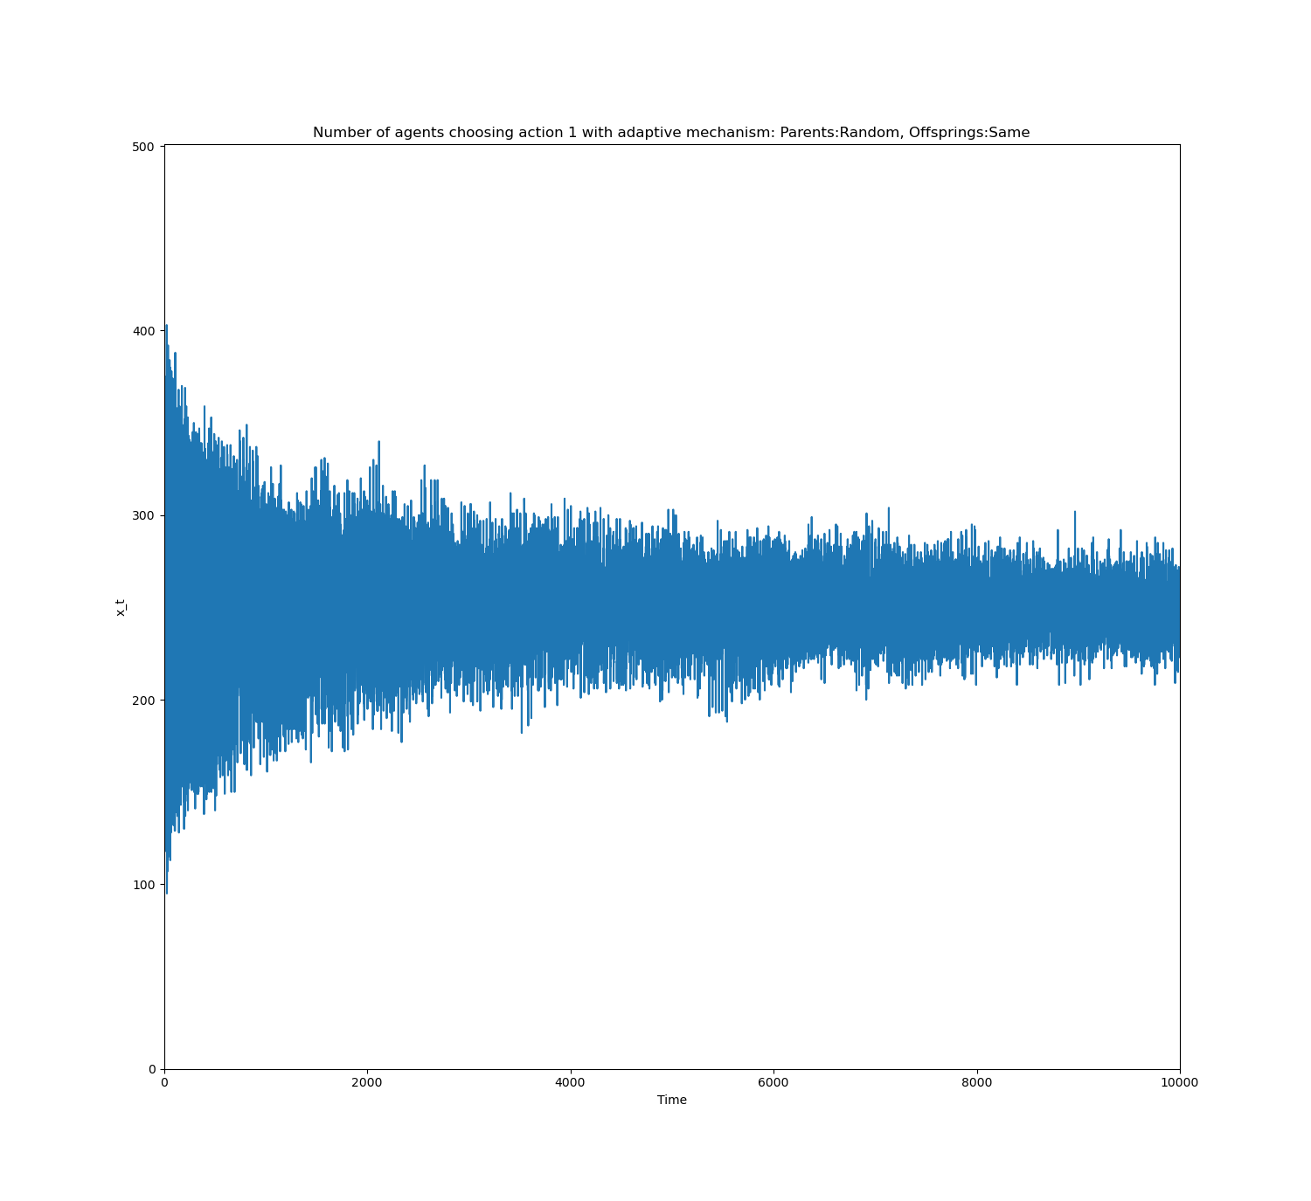
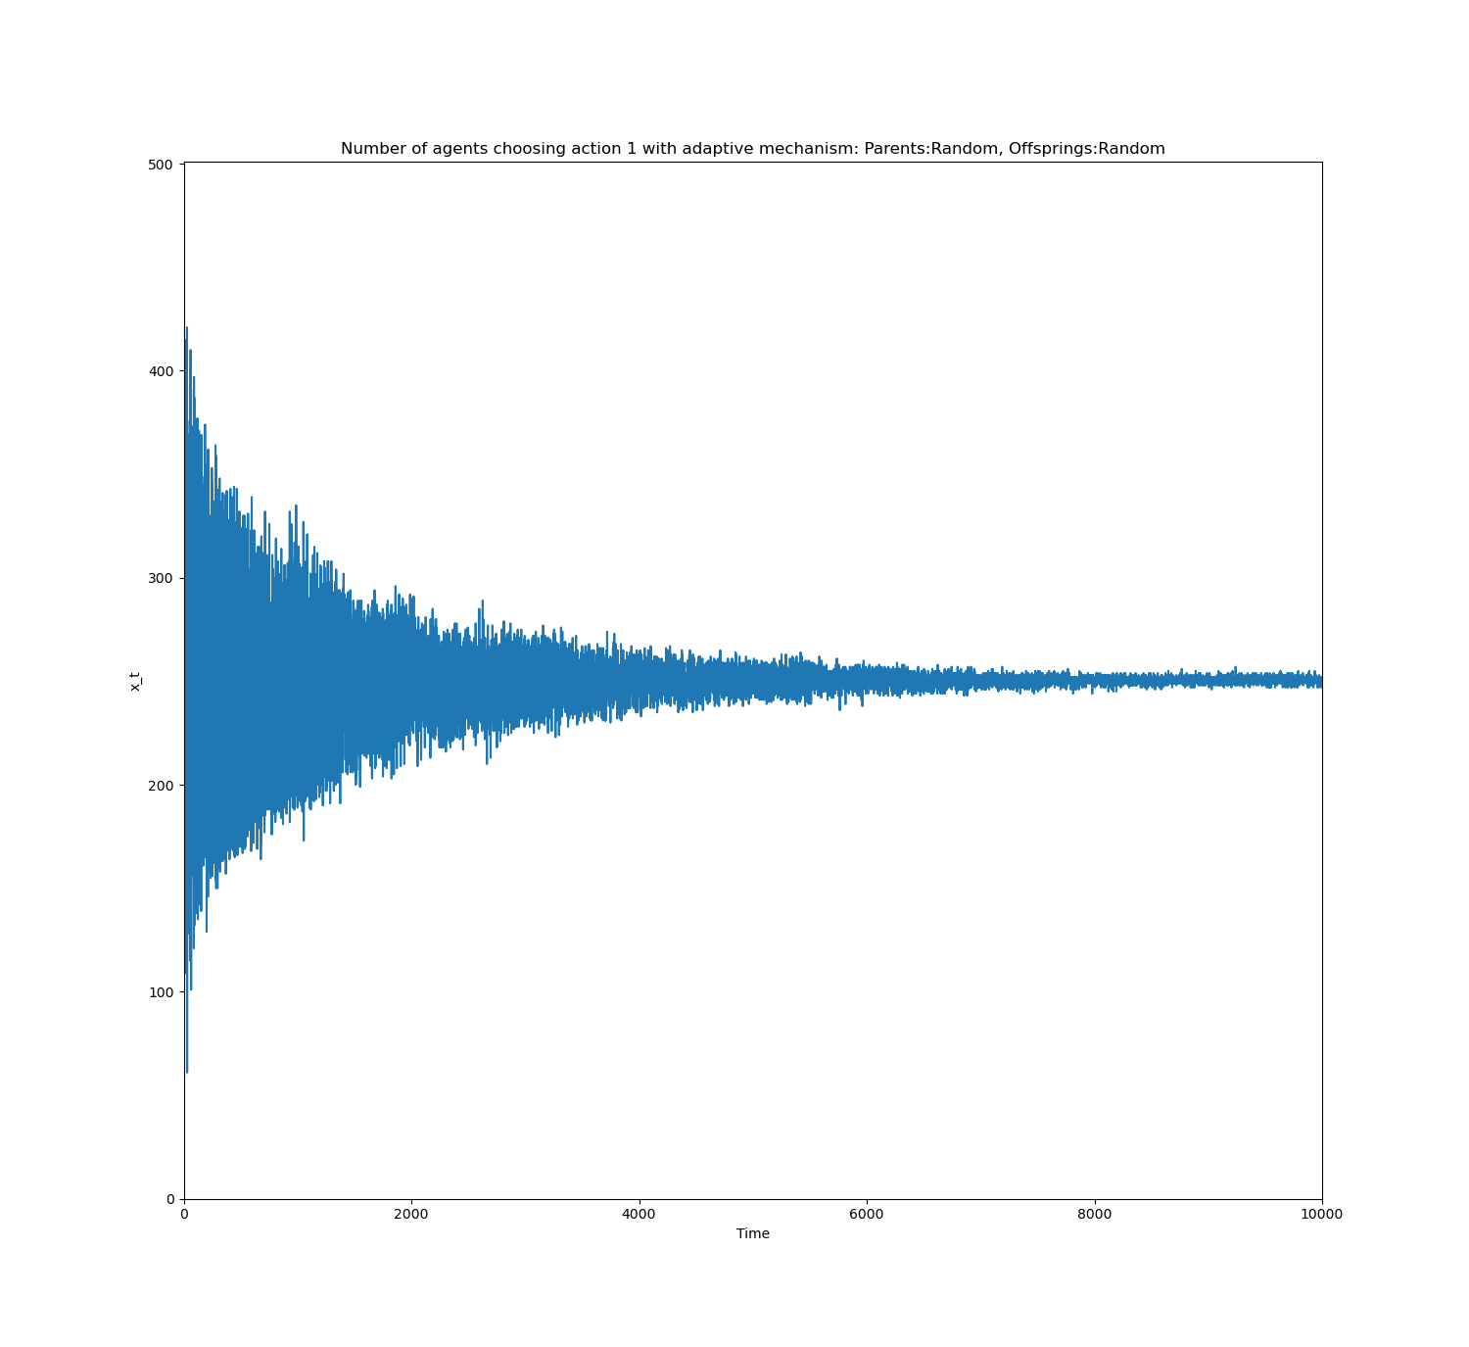
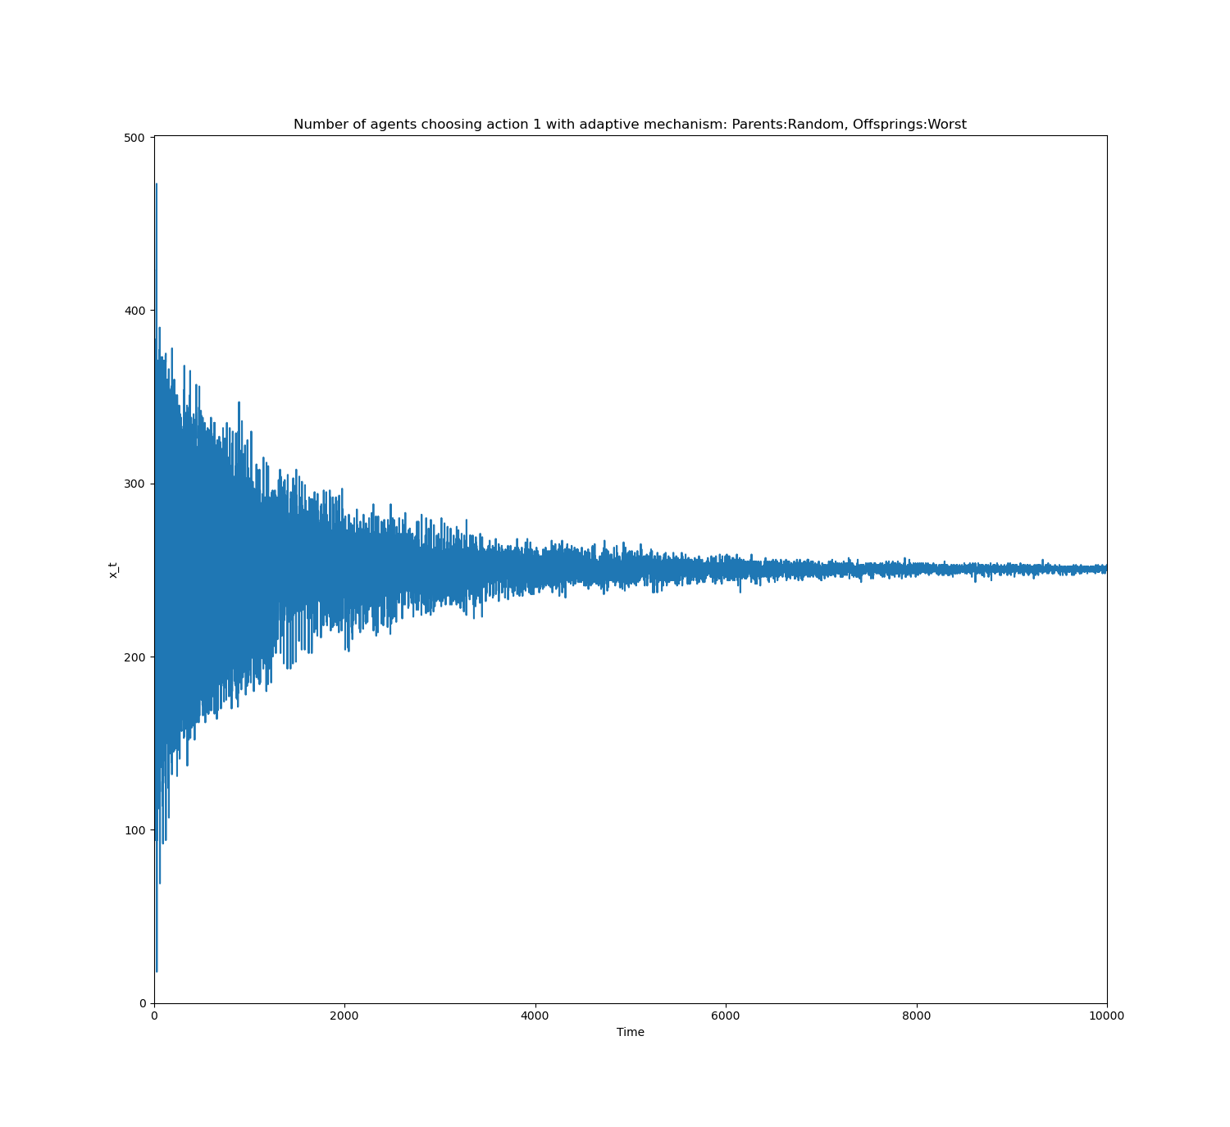
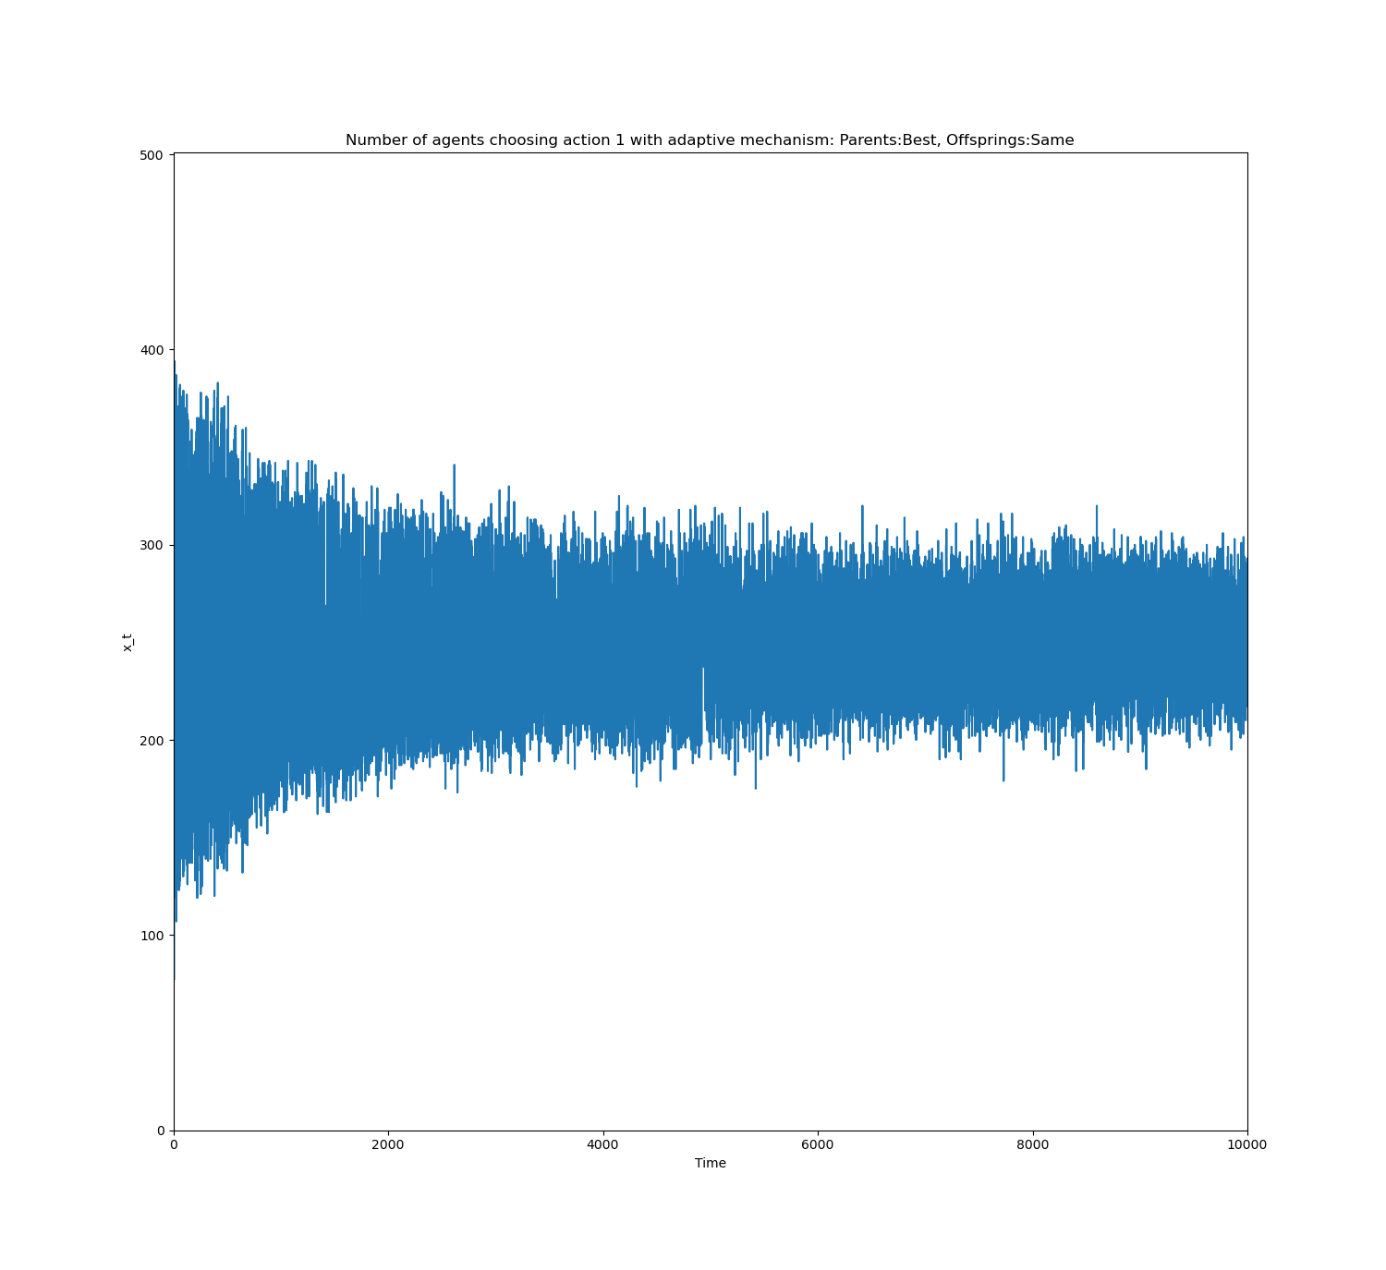
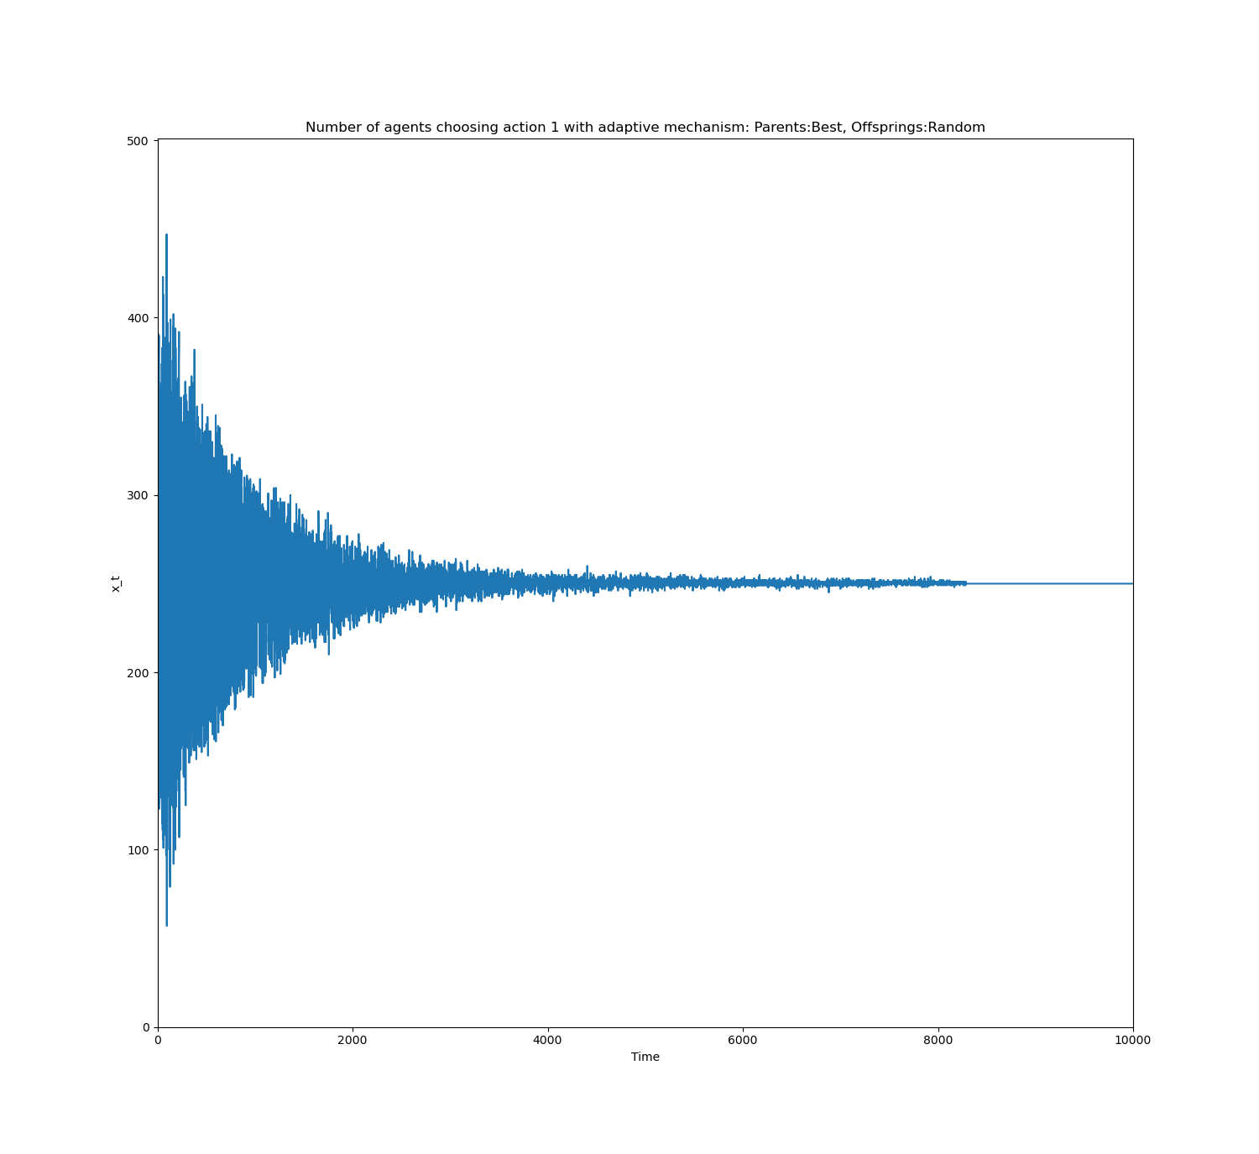
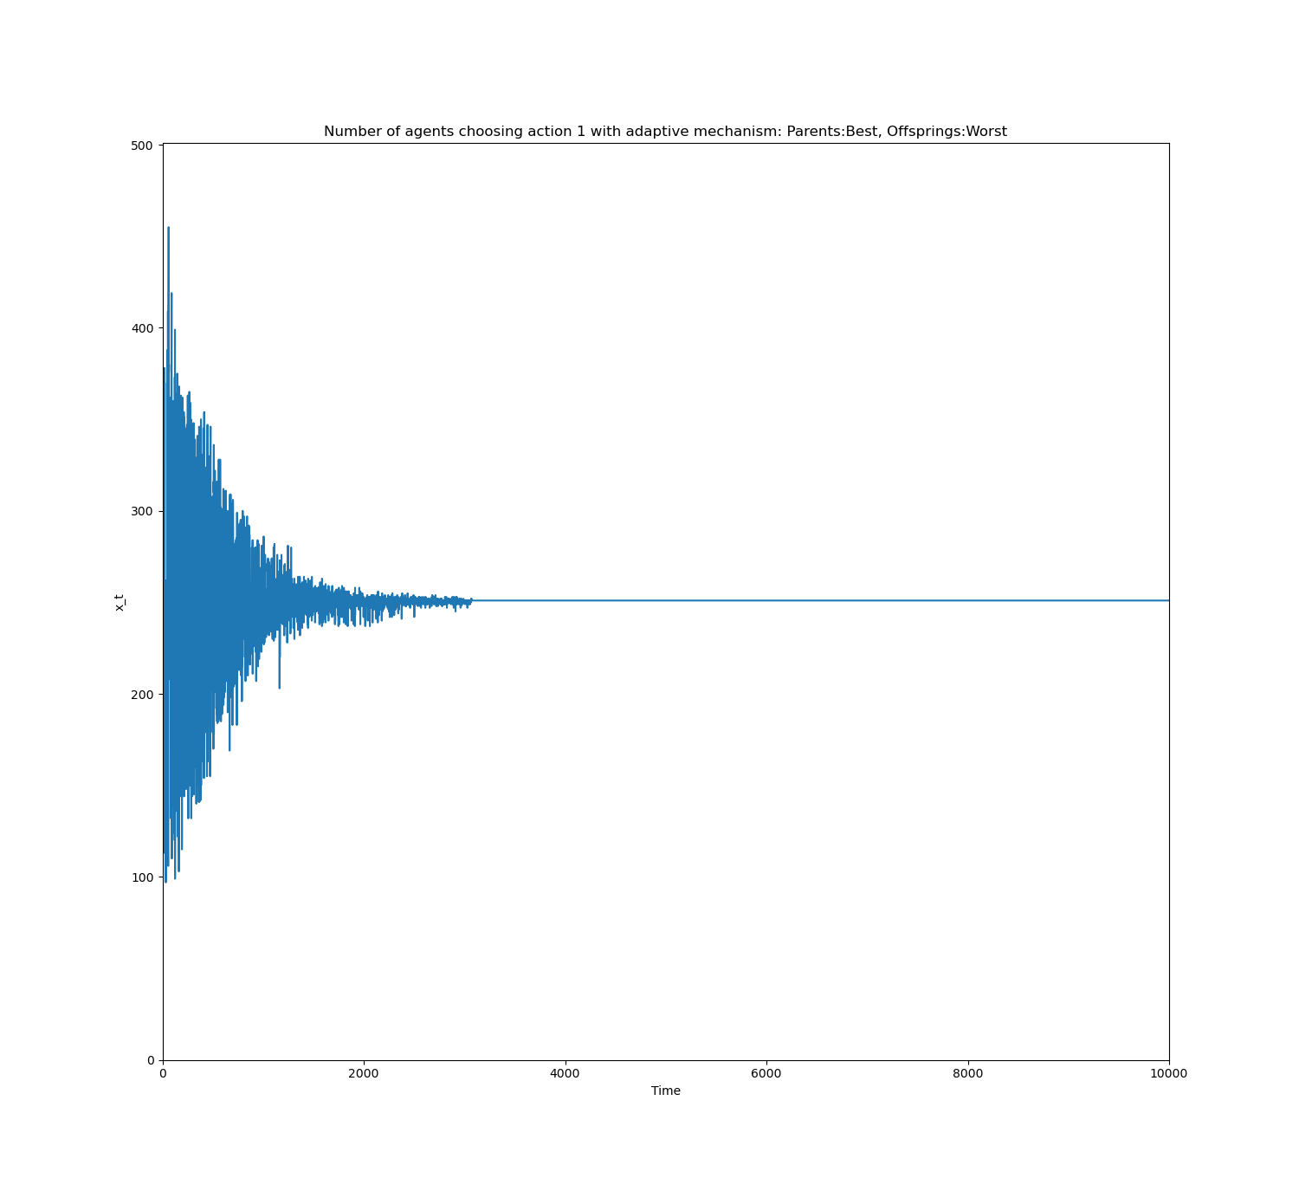
Collective Behaviors (Crossover)
A
B
C
D
E
F

Slide 12
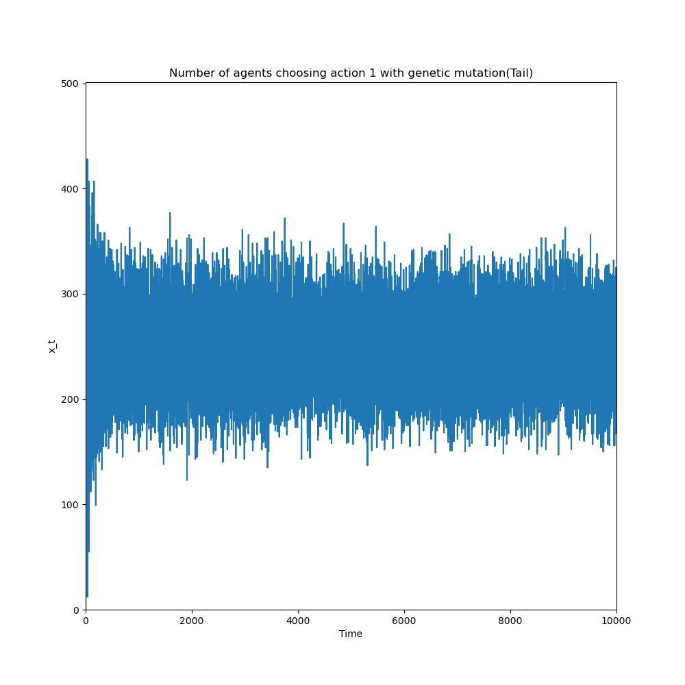
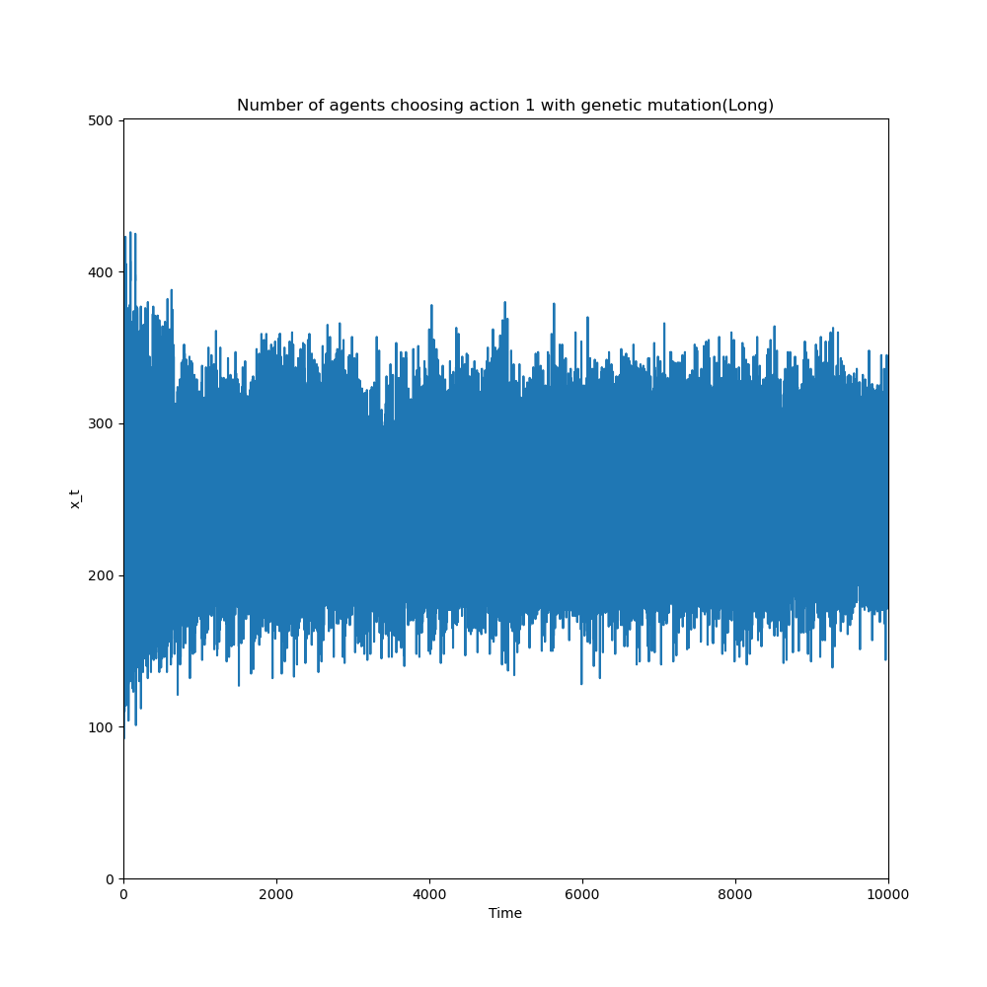
Collective Behaviors (Mutation)
G
H

Slide 13
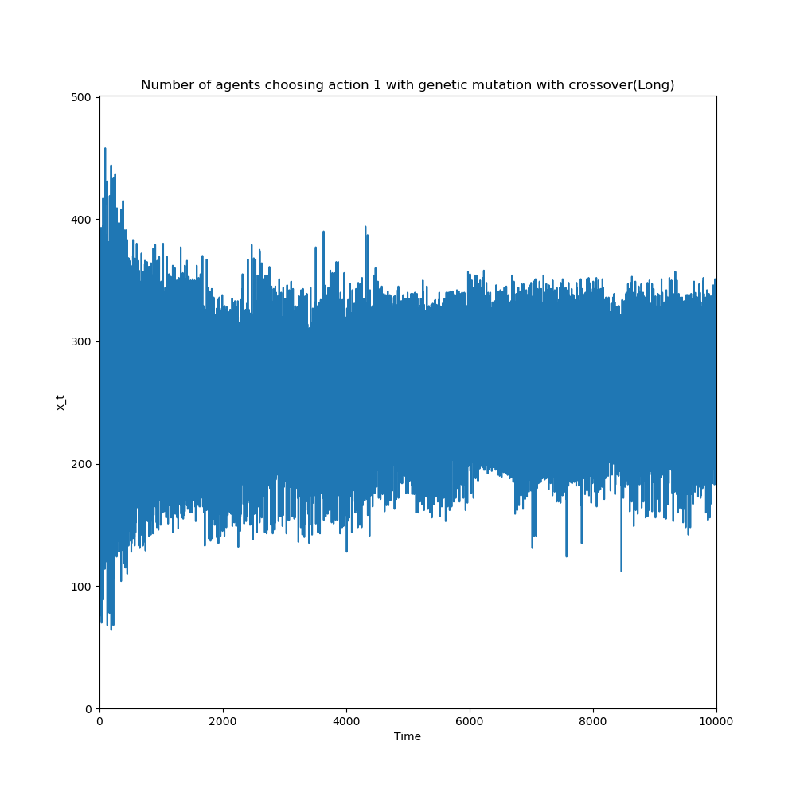
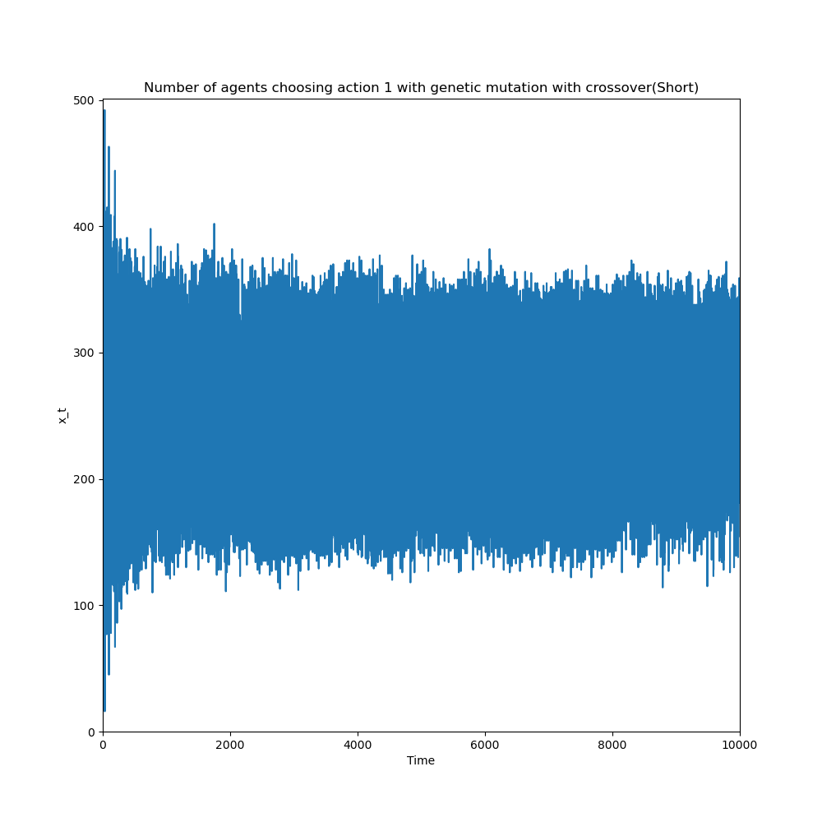
Collective Behaviors (Crossover-mutation)
I
J

Slide 14
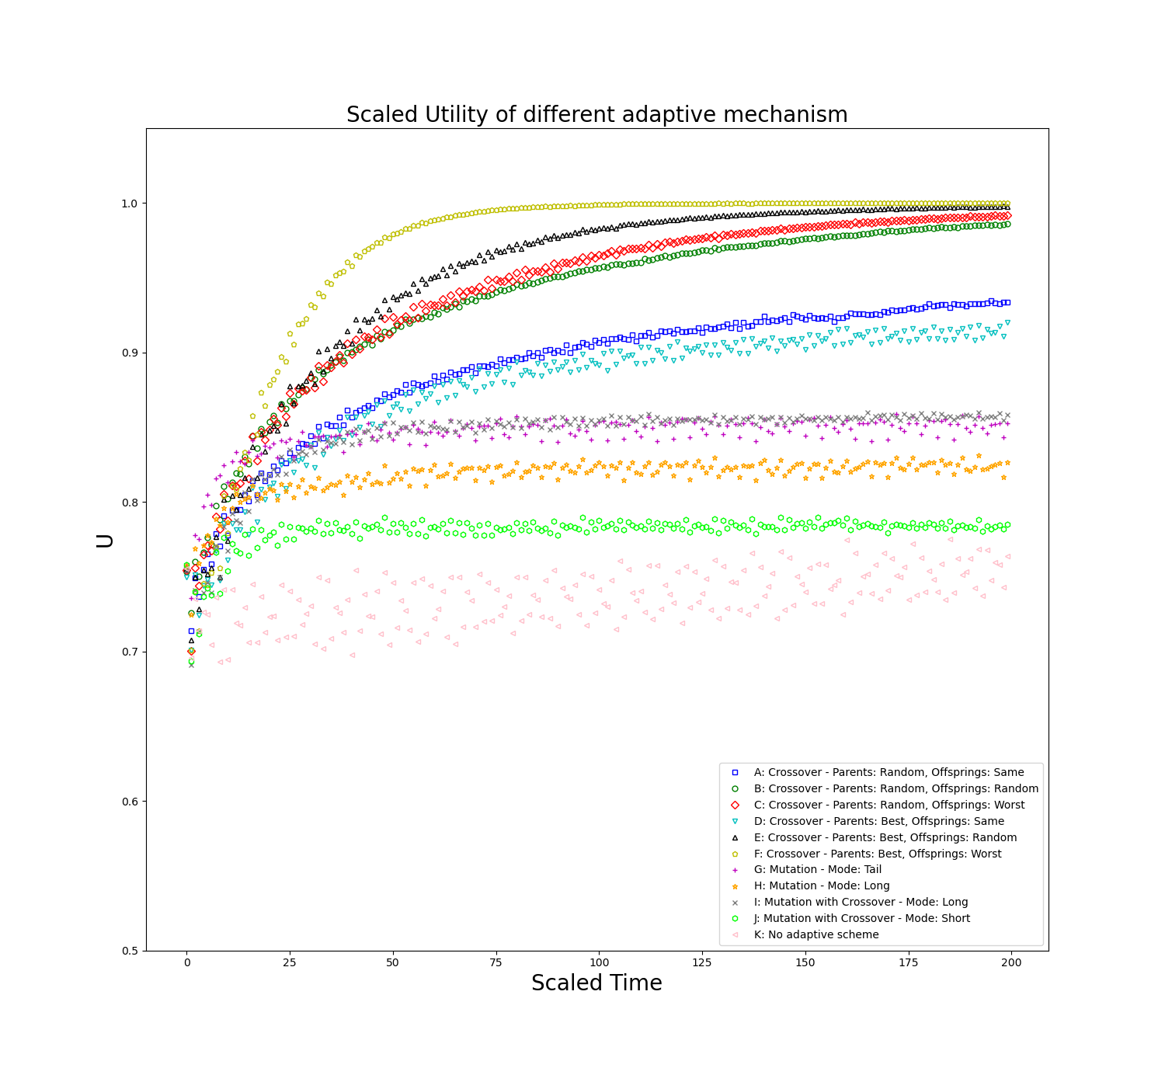
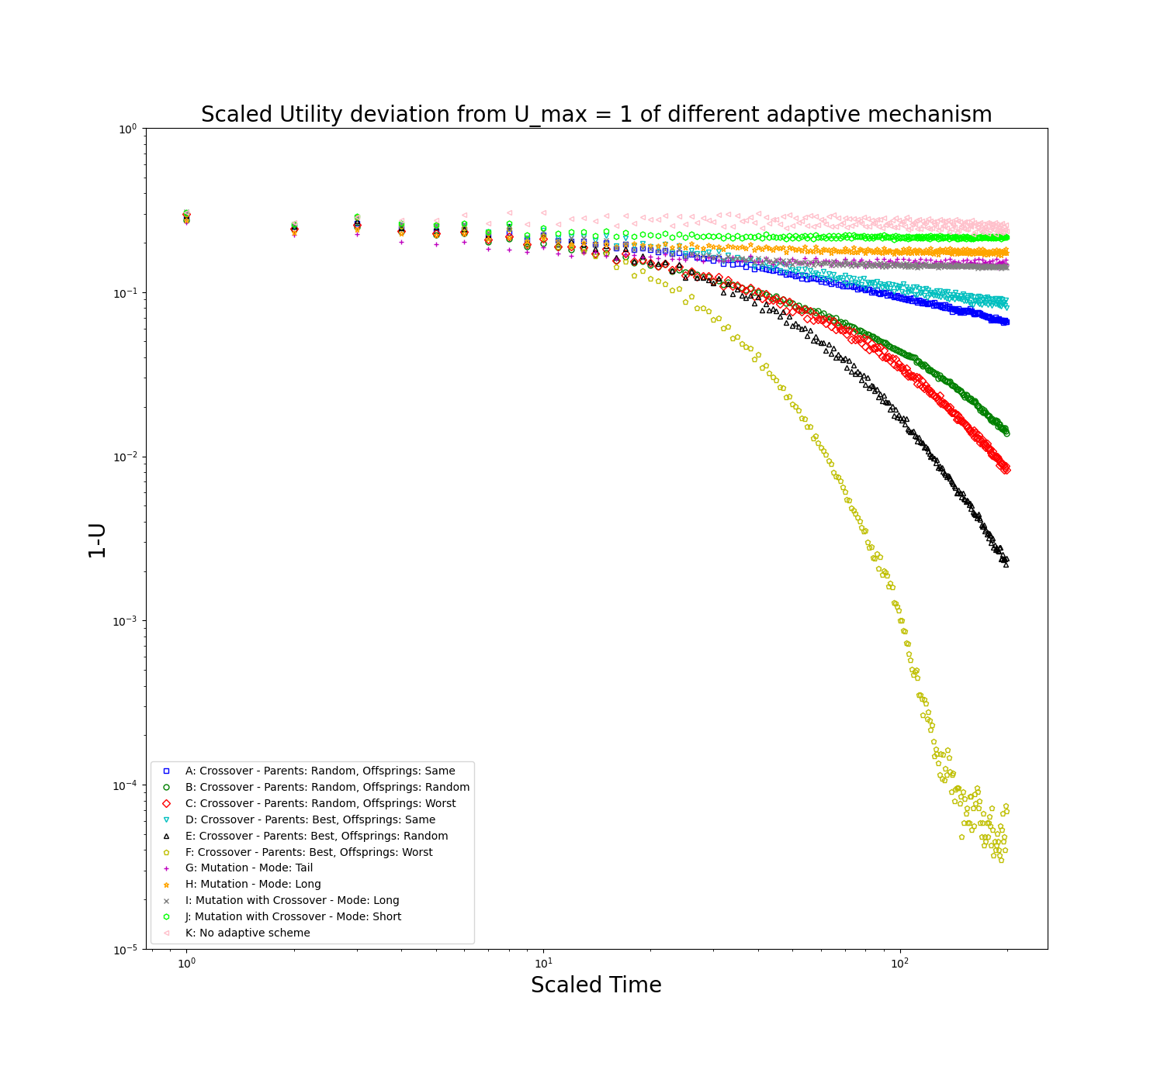
Collective Behaviors (Scaled utility)
Average over 30 runs
Scheme F is the most efficient
Crossover schemes are more efficient than mutation and crossover-mutation
Scheme A and D are relative less efficient than other crossover schemes
Scheme G and I are close

Slide 15

Revenging Ability
Can the adaptive schemes turn a losing agent to a winning agent?
Again, simulation with N=501, m=4, S=10, T=10000, $τ$=40, n=0.3
At t=3000, the 5 worst performing agents are allowed to apply adaptive scheme
Other agents continue to play with their own strategies
Separate games are simulated with different adaptive scheme

Slide 16
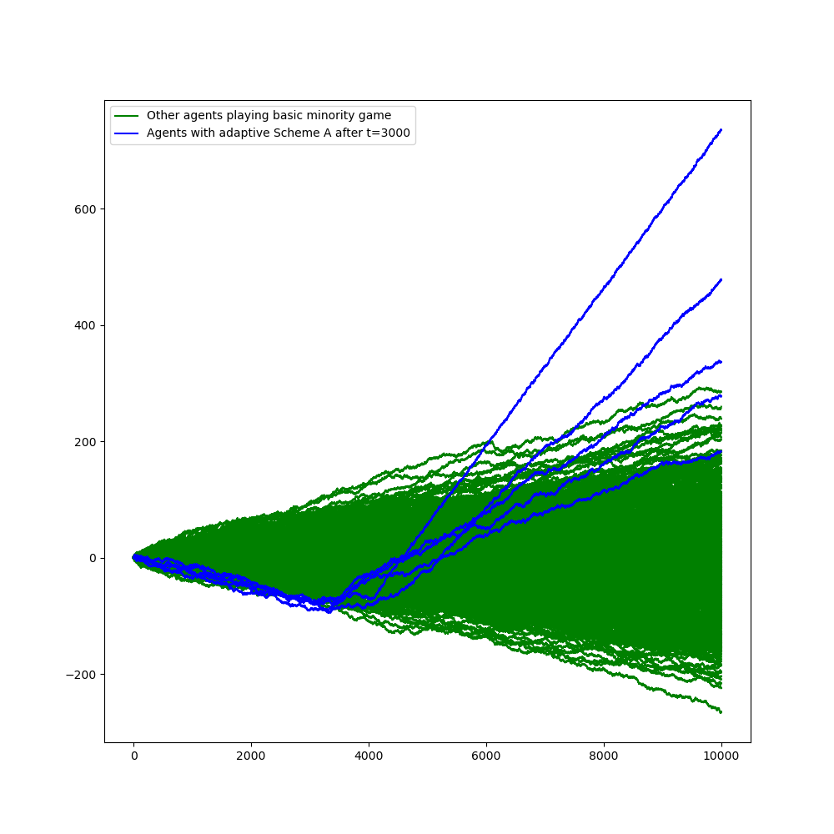
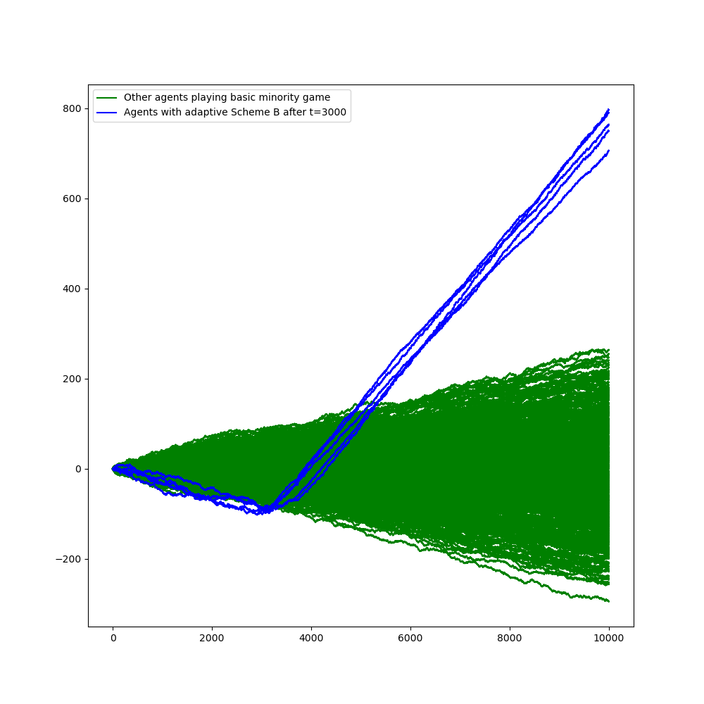
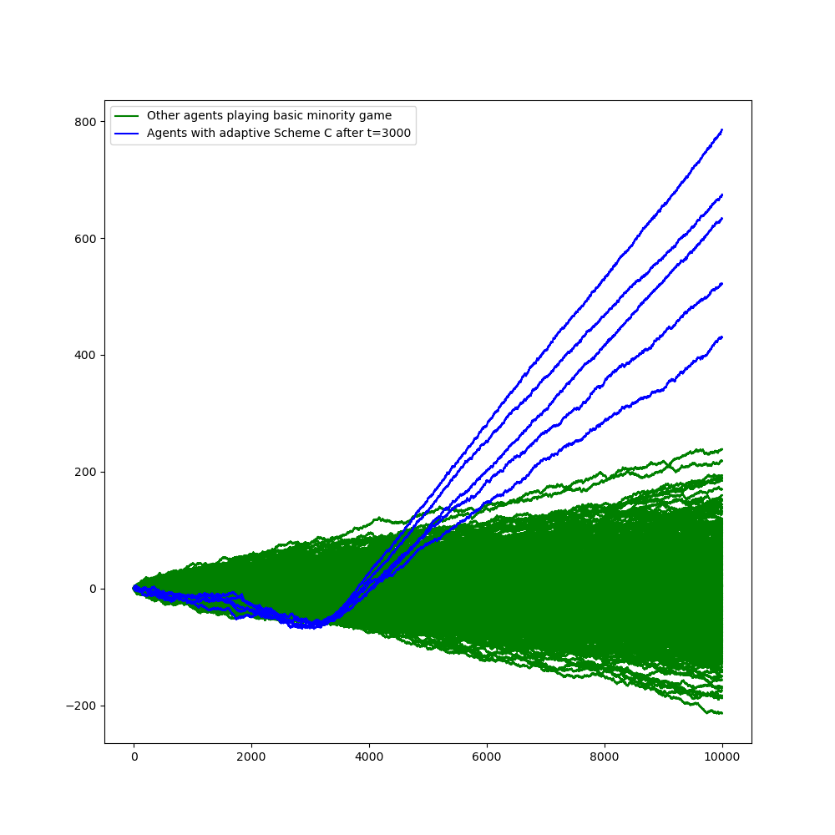
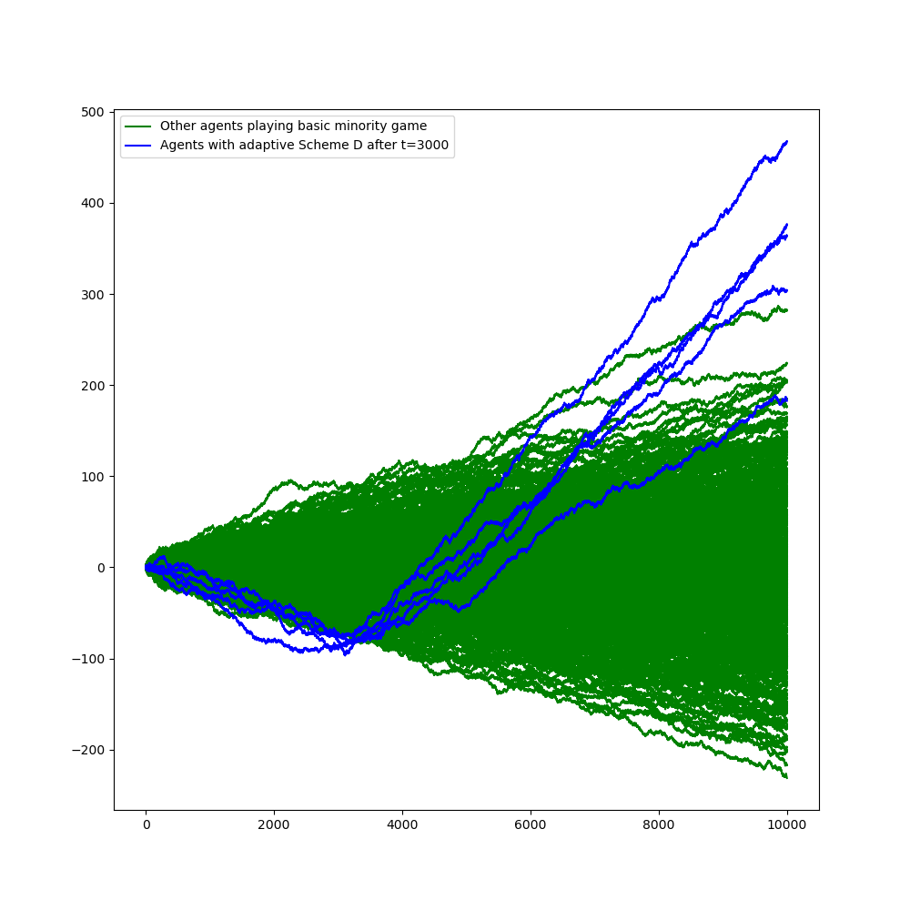
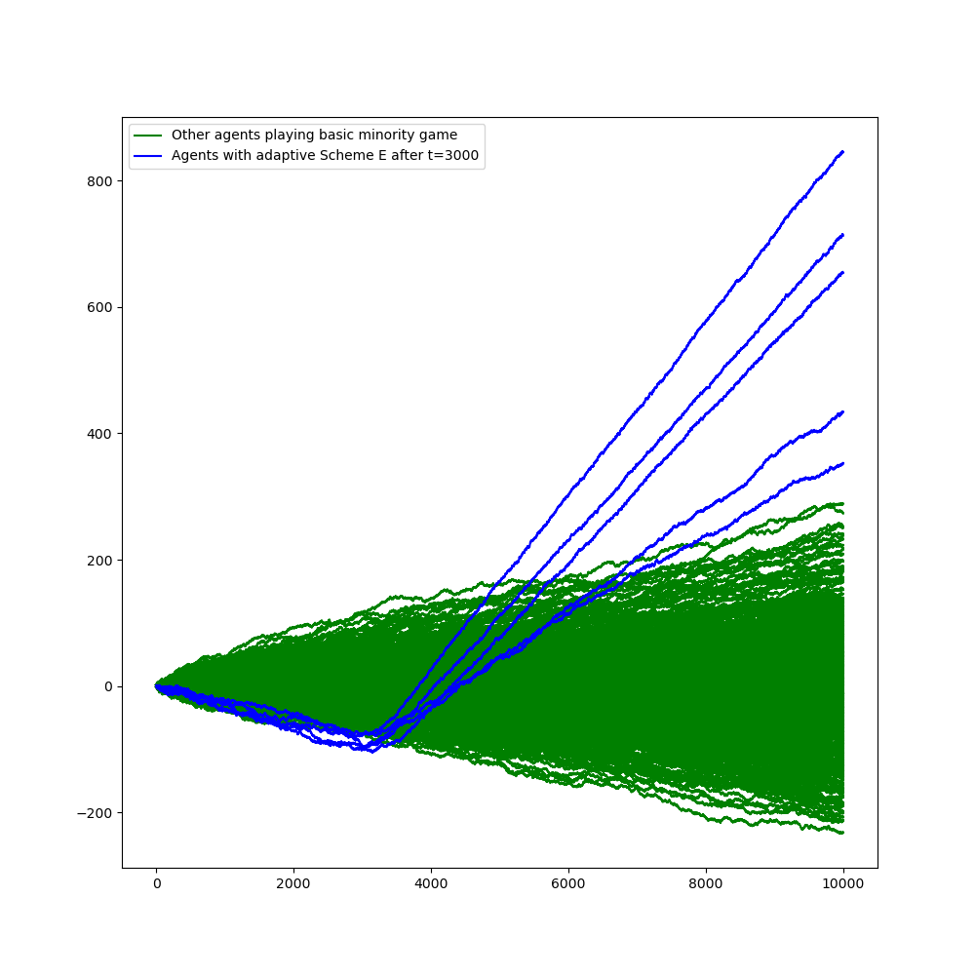
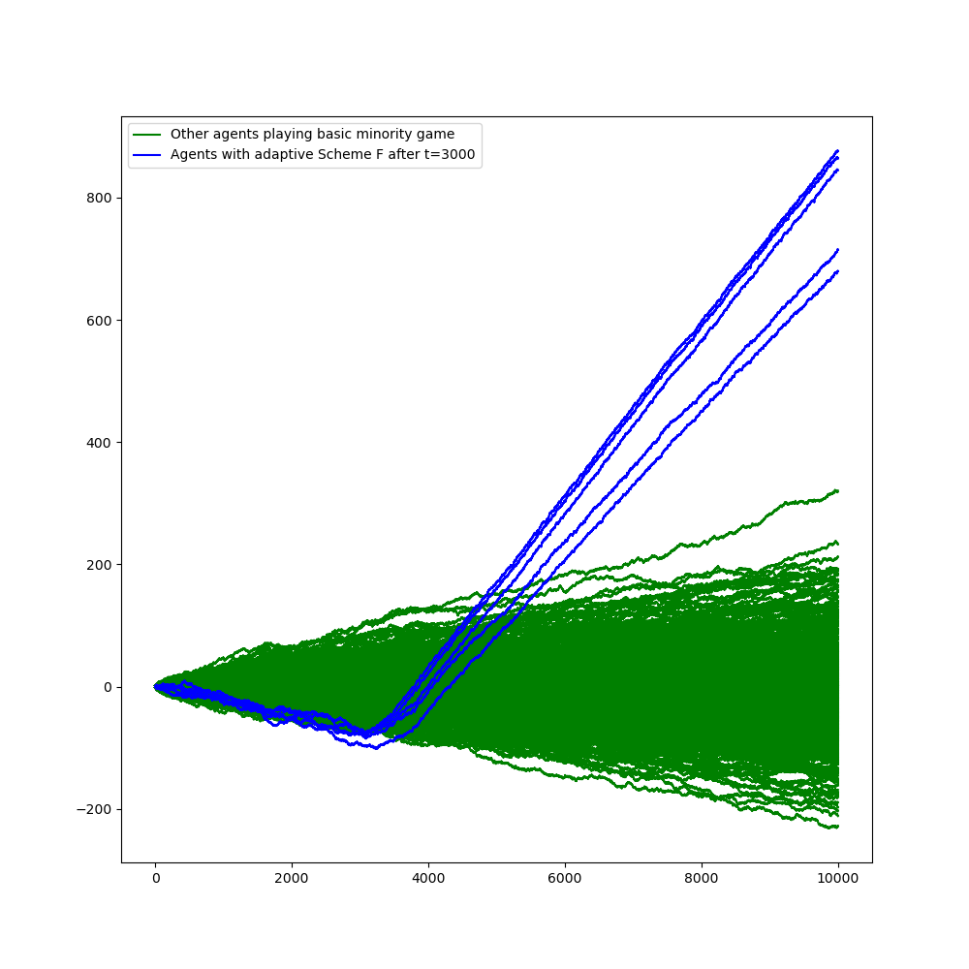
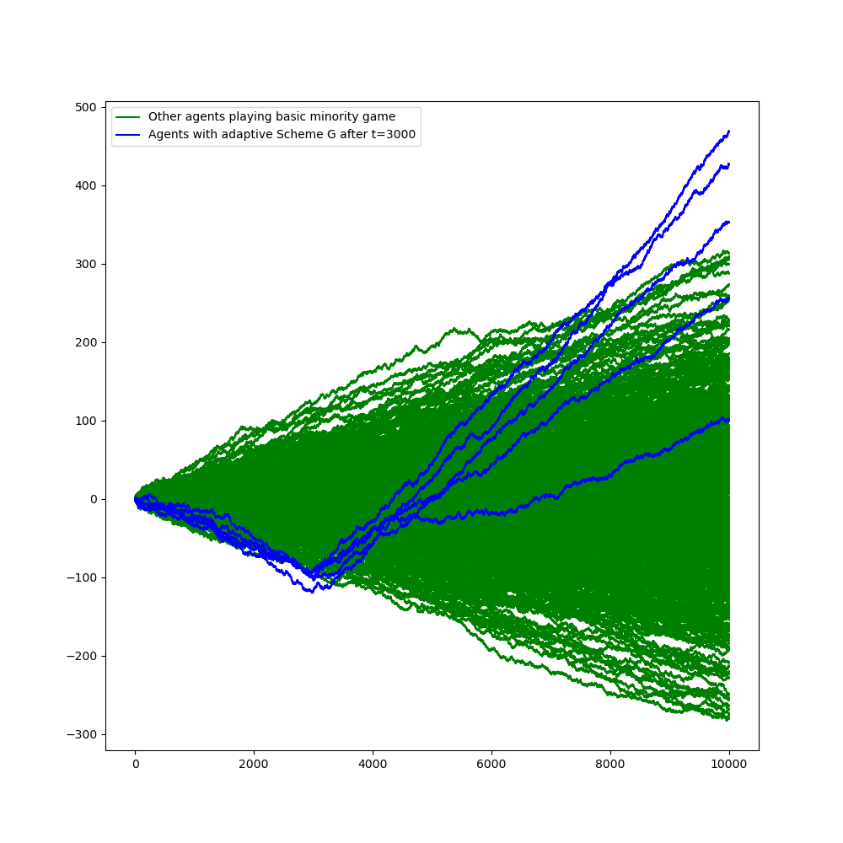
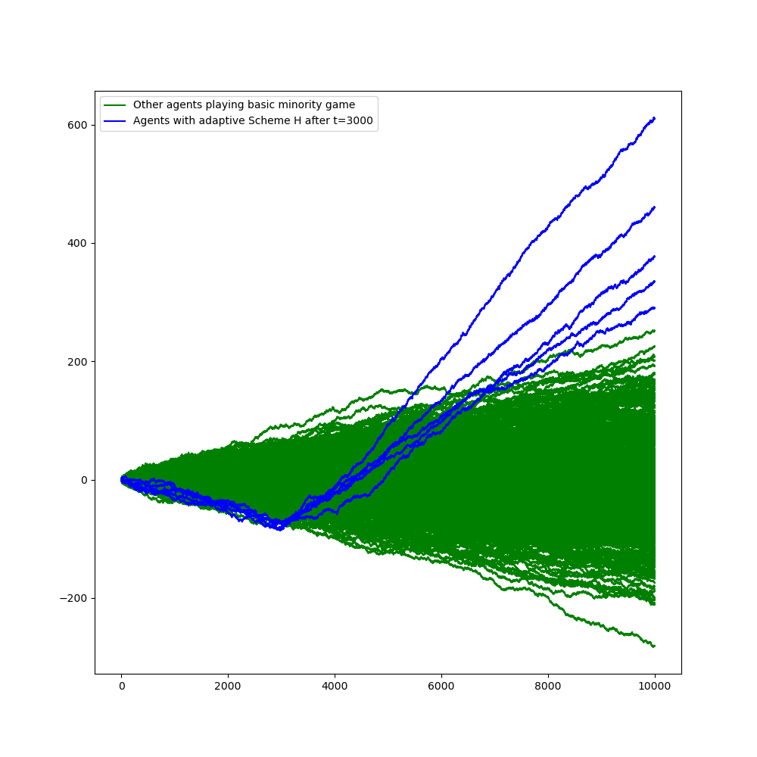
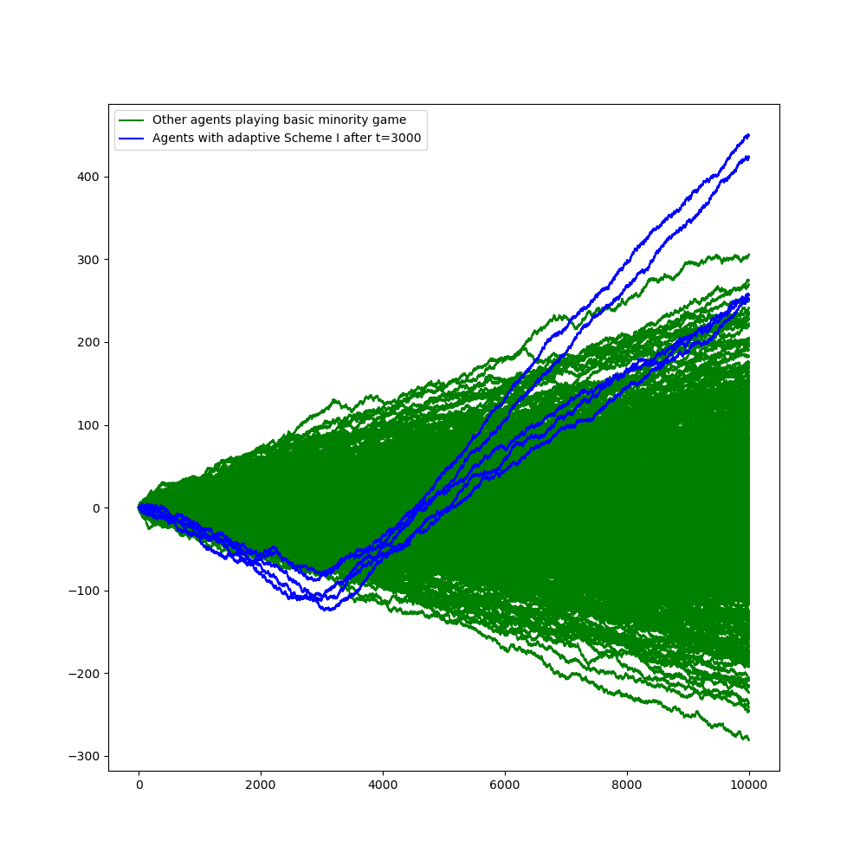
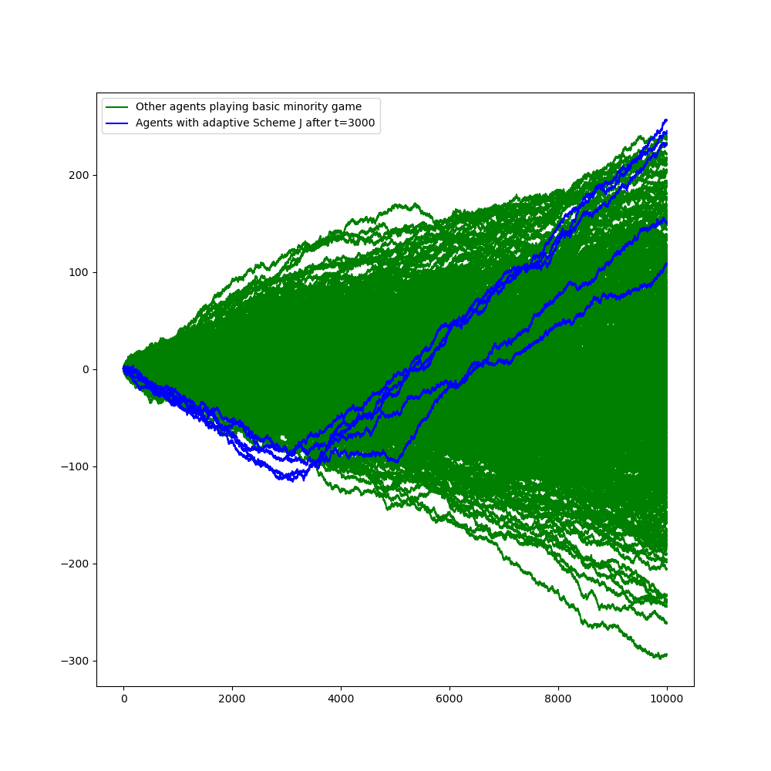
Revenging Ability
Slope changes from negative to positive since t=3000
All adaptive schemes have shown their revenging ability
A
B
C
D
E
F
G
H
I
J

Slide 17
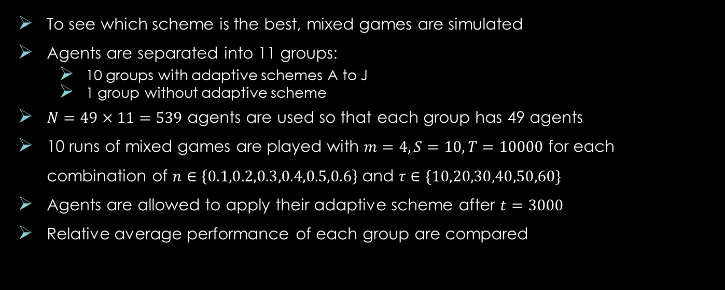
Relative Performance
To see which scheme is the best, mixed games are simulated
Agents are separated into 11 groups:
10 groups with adaptive schemes A to J
1 group without adaptive scheme
$N=49×11=539$ agents are used so that each group has 49 agents
10 runs of mixed games are played with $m=4, S=10, T=10000$ for each combination of $n∈\left\{0.1,0.2,0.3,0.4,0.5,0.6\right\}$ and $τ∈\{10,20,30,40,50,60\}$
Agents are allowed to apply their adaptive scheme after $t=3000$
Relative average performance of each group are compared

Slide 18
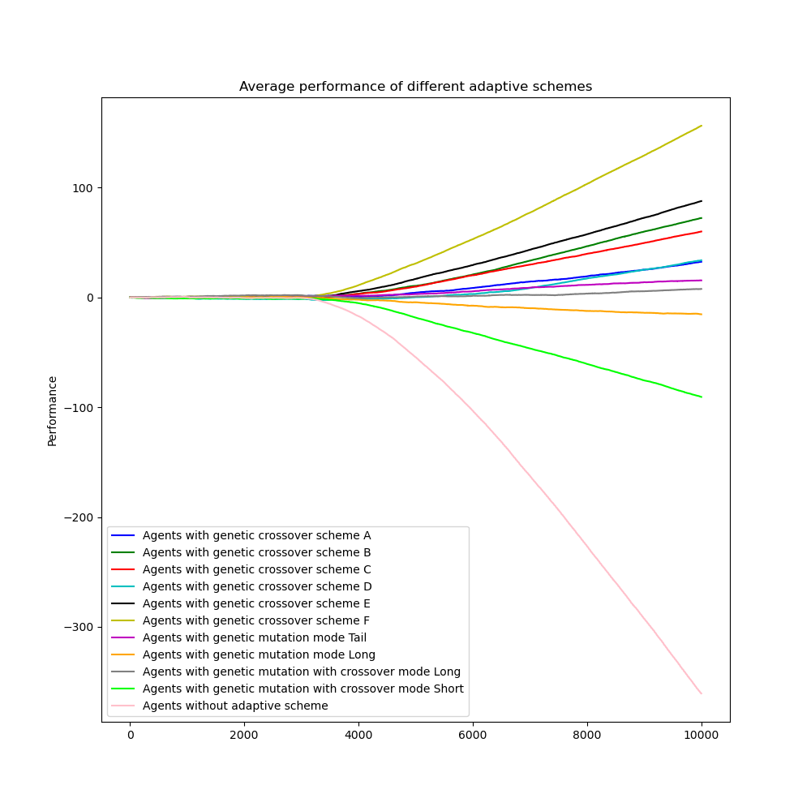
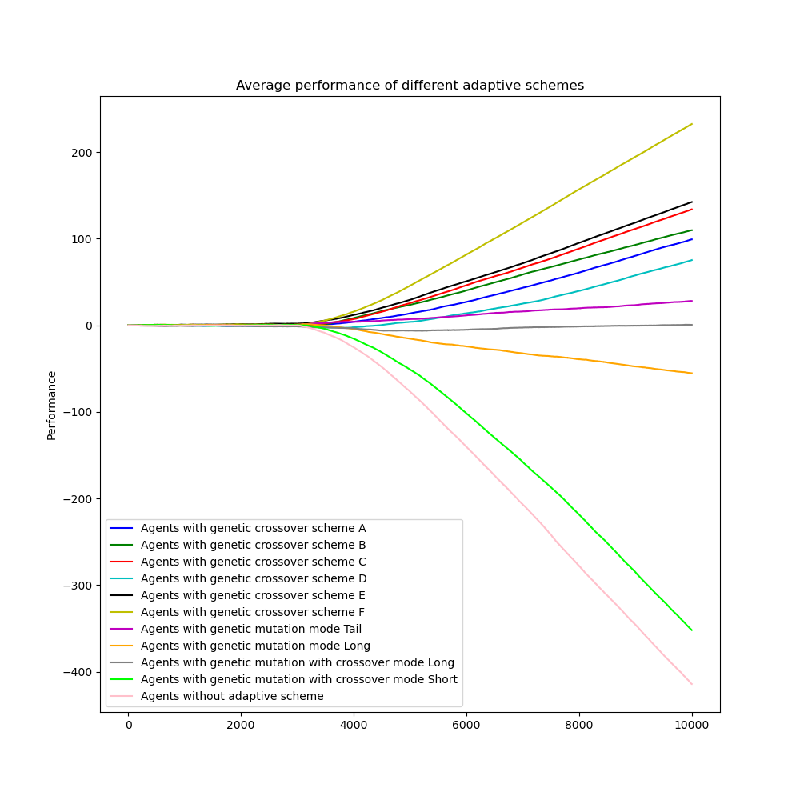
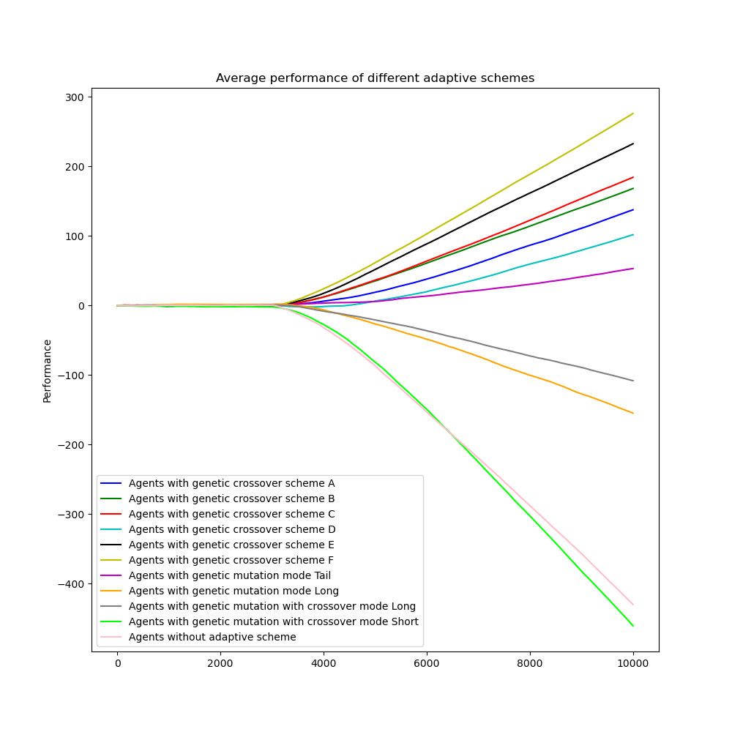
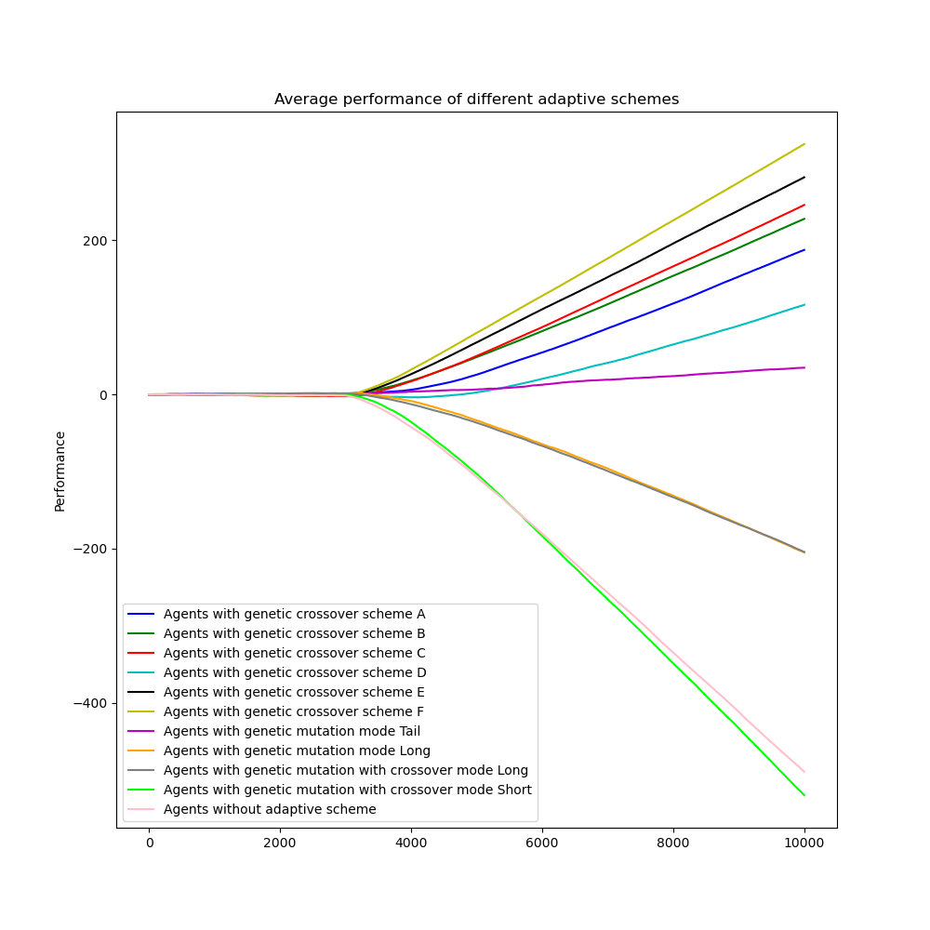
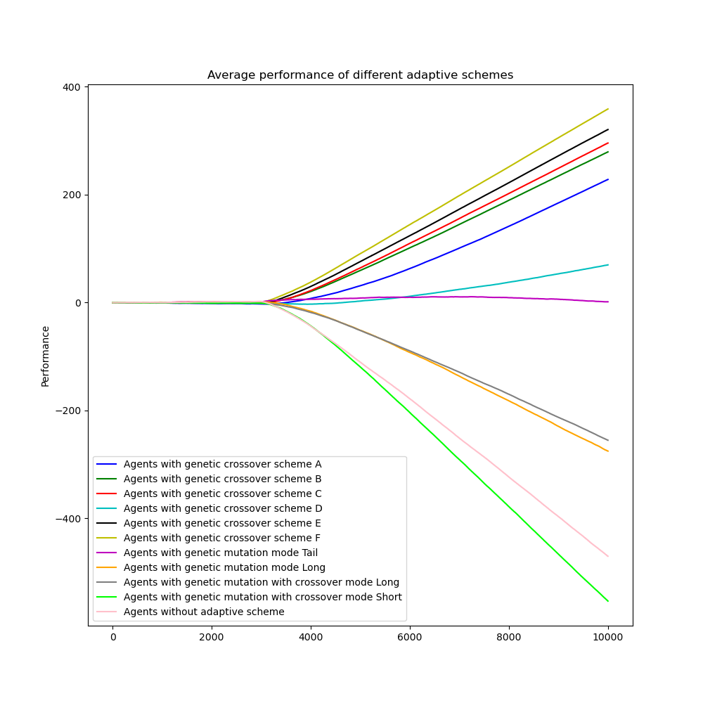
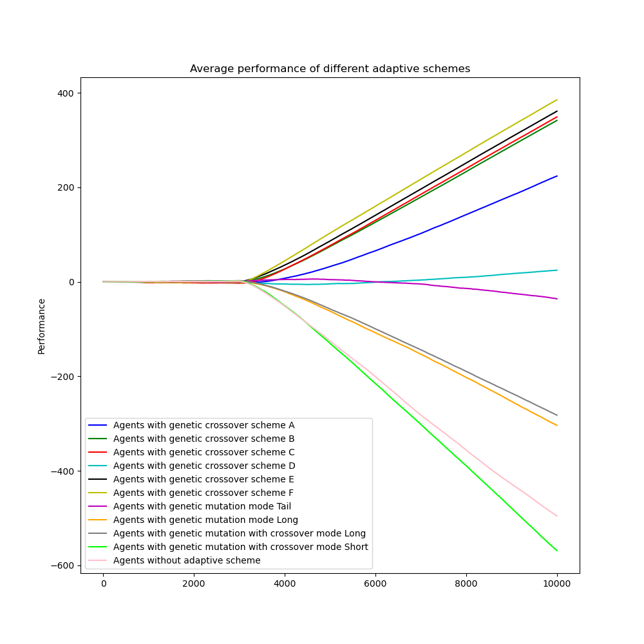
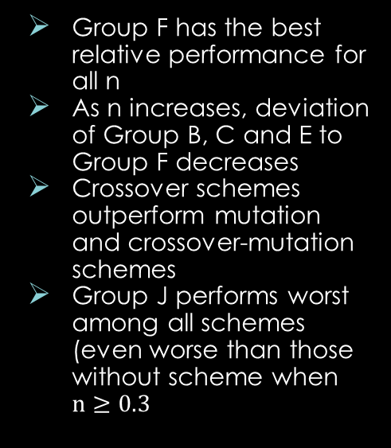
Relative Performance $(τ=10)$
Group F has the best relative performance for all n
As n increases, deviation of Group B, C and E to Group F decreases
Crossover schemes outperform mutation and crossover-mutation schemes
Group J performs worst among all schemes (even worse than those without scheme when $n≥0.3$
n=0.1
n=0.2
n=0.3
n=0.4
n=0.5
n=0.6

Slide 19
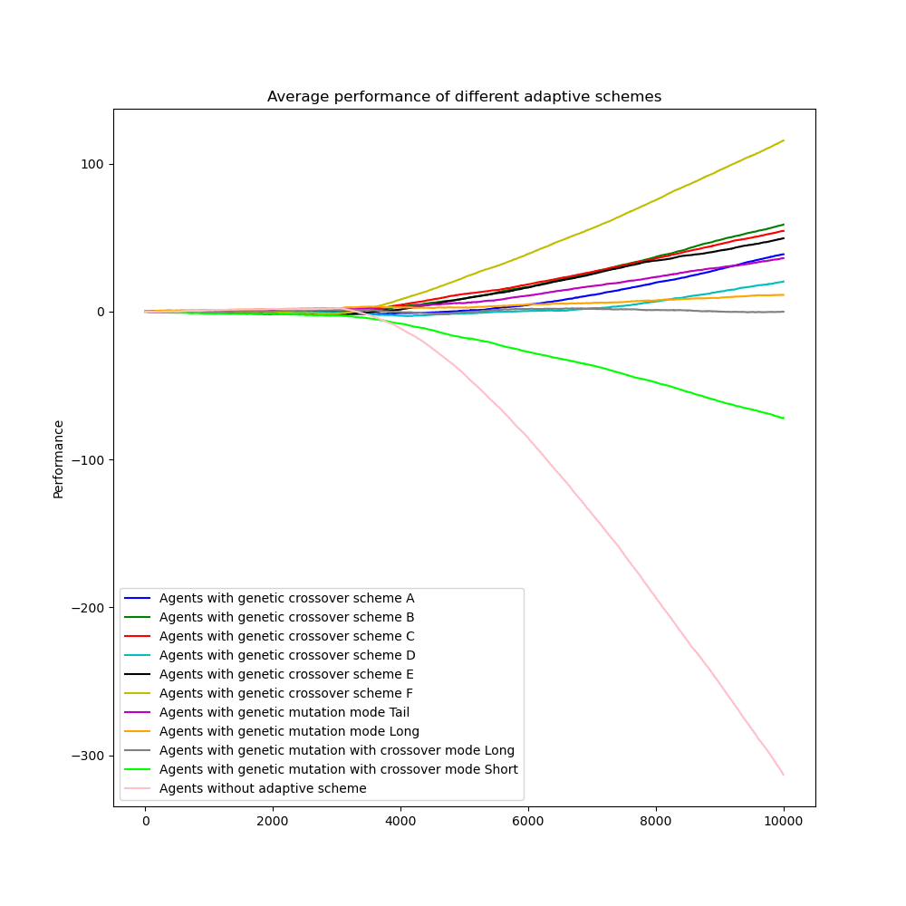
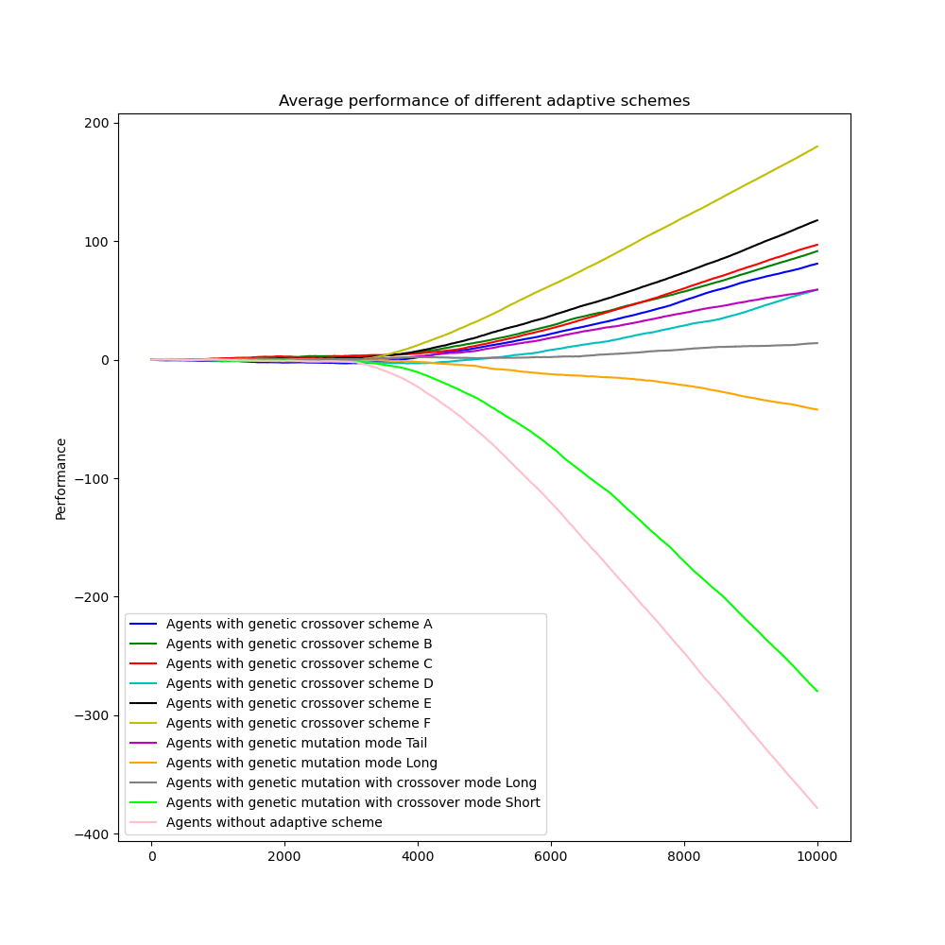
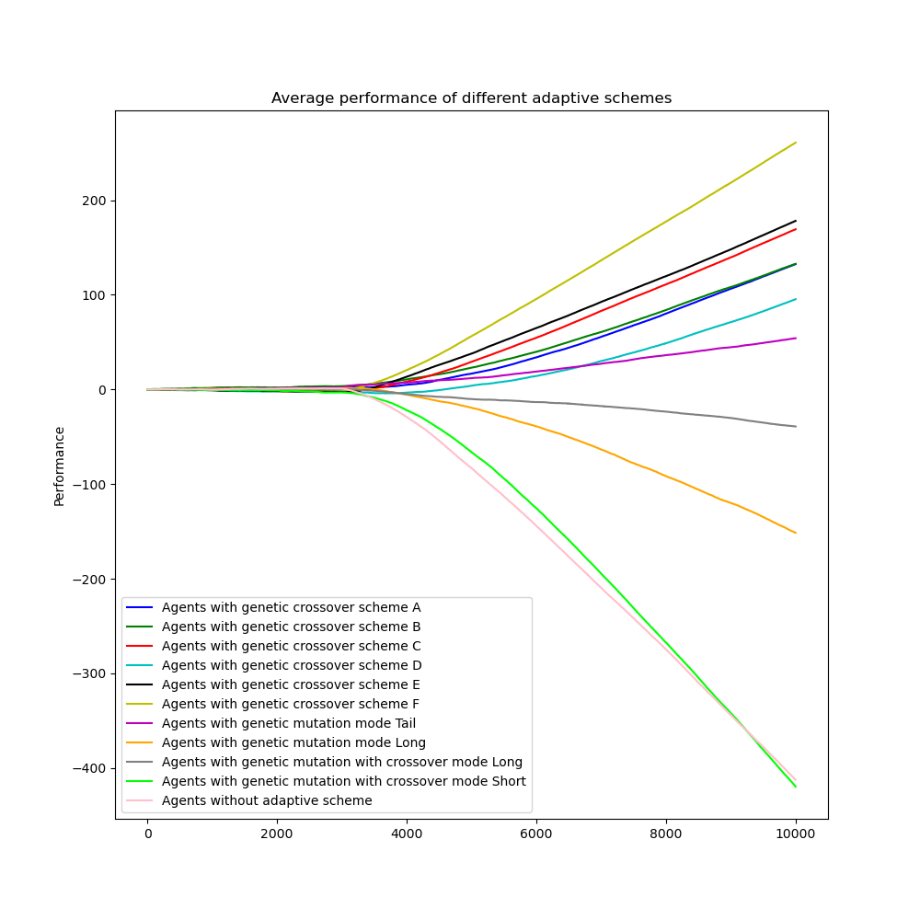
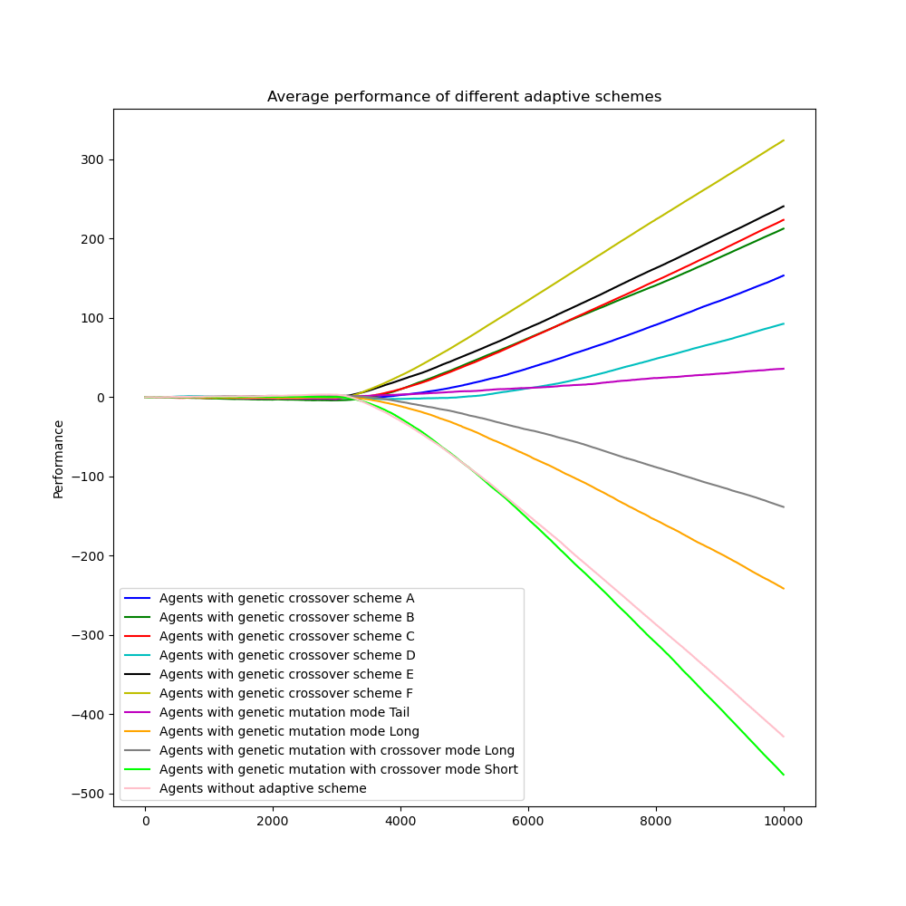
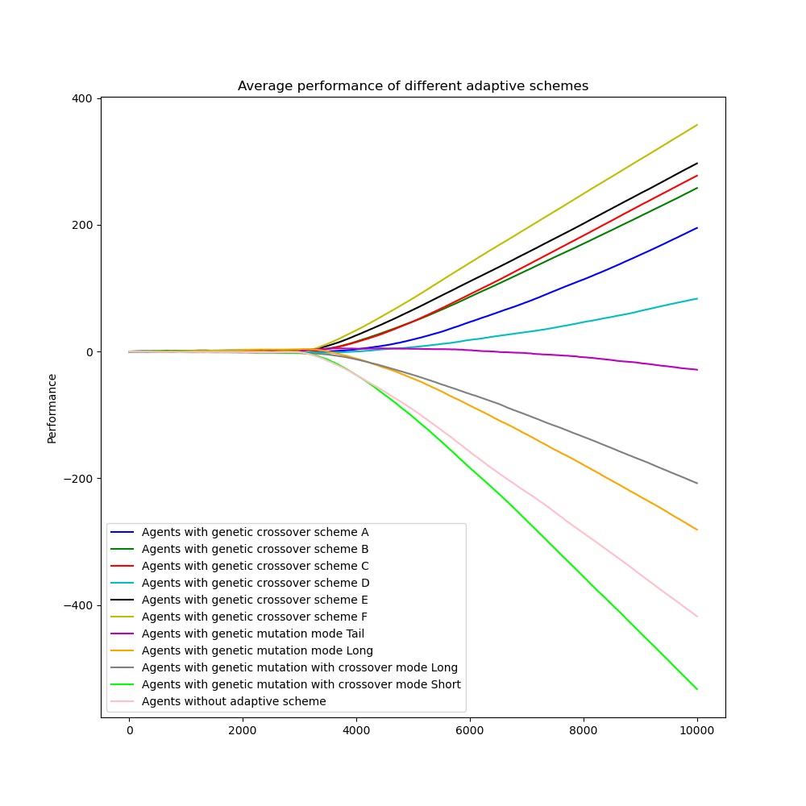
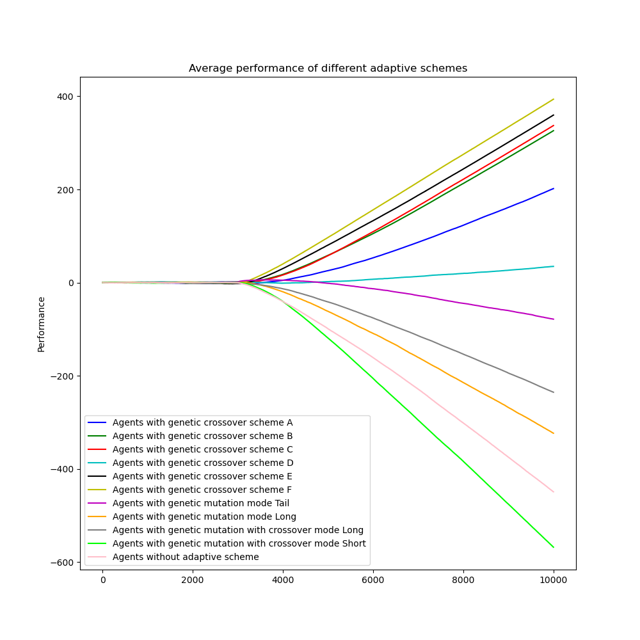

Relative Performance $(τ=20)$
Similar patterns to $τ=10$are observed
The range of relative performance reduced for small n
n=0.1
n=0.2
n=0.3
n=0.4
n=0.5
n=0.6

Slide 20
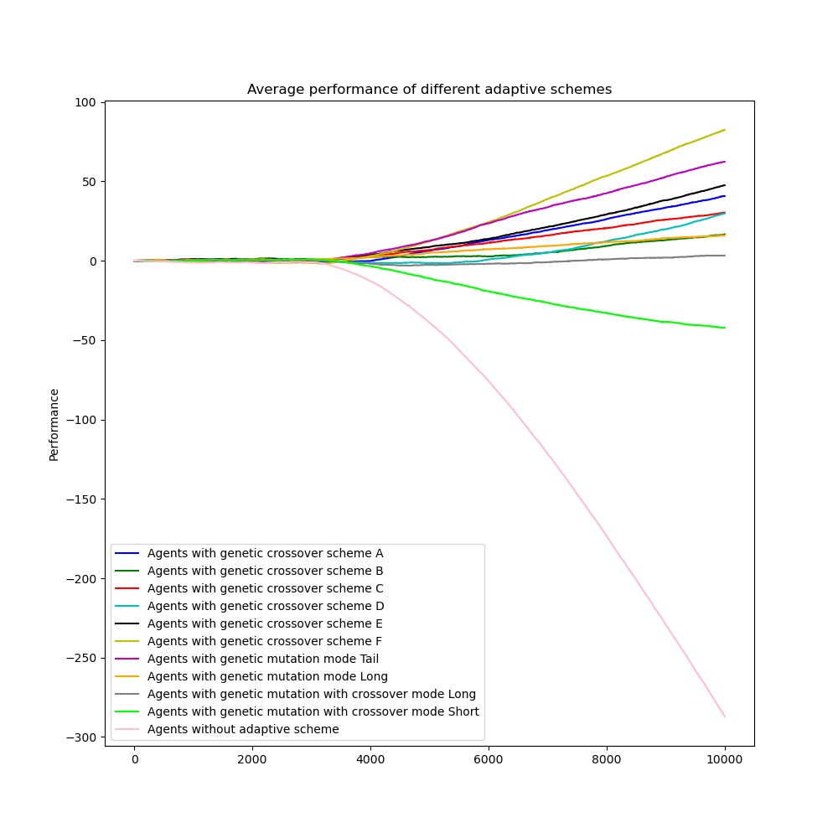
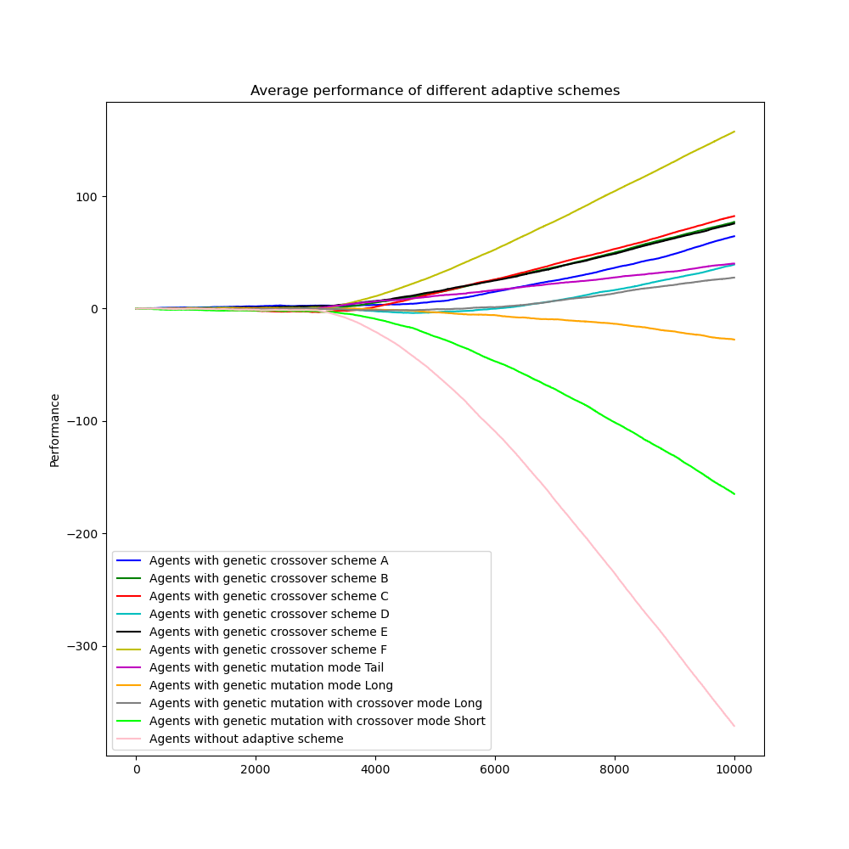
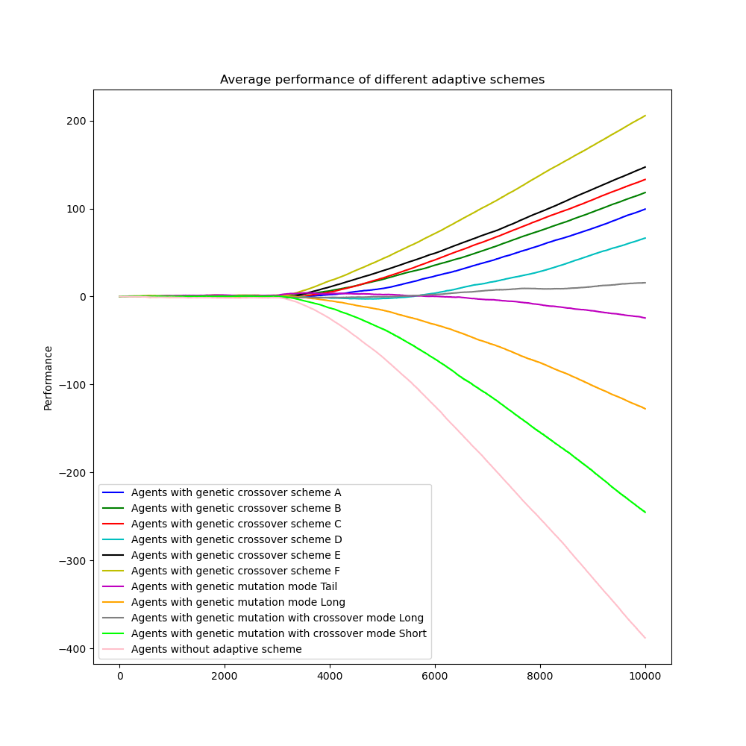
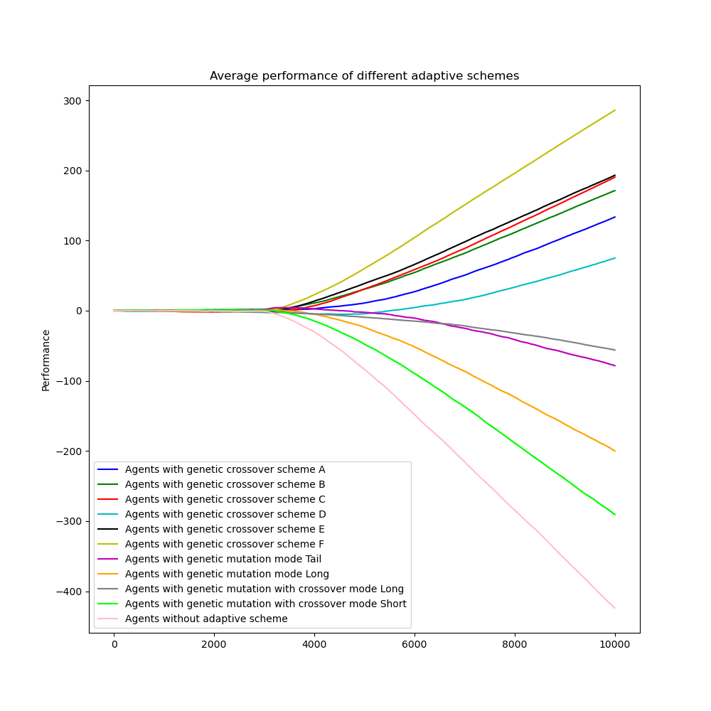



Relative Performance $(τ=30)$
Group F is still the best performing group for all n
Group G rank 2nd when $n=0.1$
All groups perform better than those without scheme
n=0.1
n=0.2
n=0.3
n=0.4
n=0.5
n=0.6

Slide 21







Relative Performance $(τ=40)$
Group G beats Group F and becomes the best when $n=0.1$
Group F is the best for $n≥0.2$
Performance of Group G decreases as n increases
Group J performs worst among all schemes (even worse than those without scheme when $n≥0.3$
n=0.1
n=0.2
n=0.3
n=0.4
n=0.5
n=0.6

Slide 22







Relative Performance $(τ=50)$
Group F is the best for all n but Group G is very close when $n=0.1$
Performance of Group G decreases as n increases
Group J performs worst among all schemes (even worse than those without scheme when $n≥0.3$
n=0.1
n=0.2
n=0.3
n=0.4
n=0.5
n=0.6

Slide 23







Relative Performance $(τ=60)$
Group G outperforms others when $n=0.1$
Group F is the best for $n≥0.2$
All but Group J perform above average when $n≤0.2$
n=0.1
n=0.2
n=0.3
n=0.4
n=0.5
n=0.6

Slide 24


Relative Performance (ranking matrix)
Scheme F is the best most of the time
In general crossover schemes outperform mutation schemes and crossover-mutation schemes
Among crossover schemes, scheme A and D are relative weaker
Scheme G performs very well when n is small and $τ$ is large
Scheme J is not a good strategy for the mixed game

Slide 25

Conclusion
Both crossover, mutation and crossover-mutation schemes could enhance the efficientcy of the system
All adaptive schemes proposed exhibit revenge abilities
Crossover schemes are best for the mixed game most of the time
When n is small and $τ$ is large, mutation schemes could compete with crossover schemes
Crossover-mutation scheme is never a good strategy for the mixed game

